Slide 1
ELEMENTARY COMBINATORICS & PROBABILITY
Lecture 3
Permutations and combinations

Slide 2
Last time
Basic counting principles
Sum rule
Product rule
Their combo
The principle of inclusion-exclusion
Size of a union of several sets

Slide 3
Graded assignment 1 is out! See Google classroom.
Deadline: tomorrow, end of the day.

Slide 4
today
Problem set 2: review.
Counting the number of possible arrangements
Permutations
Combinations
Problem set 3

Slide 5
numbers
How many integer numbers from 1 to 100 are not divisible neither by 2 nor by 3? 100 integer numbers in total. [100 / 2] = 50 are divisible by 2. [100 / 3] = 33 are divisible by 3. [100 / 6] = 16 are divisible by both 2 and 3. 50 + 33 – 16 = 67 are divisible by 3 or by 2 (or by both). 100 – 67 = 33 are not divisible by neither.

Slide 6
numbers
How many integer numbers from 1 to 100 are not divisible neither by 2 nor by 3? 100 integer numbers in total. [100 / 2] = 50 are divisible by 2. [100 / 3] = 33 are divisible by 3. [100 / 6] = 16 are divisible by both 2 and 3. 50 + 33 – 16 = 67 are divisible by 3 or by 2 (or by both). 100 – 67 = 33 are not divisible by neither.

Slide 7
numbers
How many integer numbers from 1 to 100 are not divisible neither by 2 nor by 3? 100 integer numbers in total. [100 / 2] = 50 are divisible by 2. [100 / 3] = 33 are divisible by 3. [100 / 6] = 16 are divisible by both 2 and 3. 50 + 33 – 16 = 67 are divisible by 3 or by 2 (or by both). 100 – 67 = 33 are not divisible by neither.

Slide 8
numbers
How many integer numbers from 1 to 100 are not divisible neither by 2 nor by 3? 100 integer numbers in total. [100 / 2] = 50 are divisible by 2. [100 / 3] = 33 are divisible by 3. [100 / 6] = 16 are divisible by both 2 and 3. 50 + 33 – 16 = 67 are divisible by 3 or by 2 (or by both). 100 – 67 = 33 are not divisible by neither.

Slide 9
numbers
How many integer numbers from 1 to 100 are not divisible neither by 2 nor by 3? 100 integer numbers in total. [100 / 2] = 50 are divisible by 2. [100 / 3] = 33 are divisible by 3. [100 / 6] = 16 are divisible by both 2 and 3. 50 + 33 – 16 = 67 are divisible by 3 or by 2 (or by both). 100 – 67 = 33 are not divisible by neither.

Slide 10
numbers
How many integer numbers from 1 to 100 are not divisible neither by 2 nor by 3? 100 integer numbers in total. [100 / 2] = 50 are divisible by 2. [100 / 3] = 33 are divisible by 3. [100 / 6] = 16 are divisible by both 2 and 3. 50 + 33 – 16 = 67 are divisible by 3 or by 2 (or by both). 100 – 67 = 33 are not divisible by neither.

Slide 11
numbers
How many integer numbers from 1 to 100 are not divisible neither by 2 nor by 3? 100 integer numbers in total. [100 / 2] = 50 are divisible by 2. [100 / 3] = 33 are divisible by 3. [100 / 6] = 16 are divisible by both 2 and 3. 50 + 33 – 16 = 67 are divisible by 3 or by 2 (or by both). 100 – 67 = 33 are not divisible by either.

Slide 12
Students and courses
A total of 36 students plan to take at least one of Discrete Mathematics, Algebra and Calculus during the coming semester:
Discrete Mathematics 23
Algebra 19
Calculus 18
Discrete Mathematics & Algebra 7
Discrete Mathematics & Calculus 9
Algebra & Calculus 11
How many students plan to take all three courses?
36 = 23 + 19 + 18 – 7 – 9 – 11 + N N = 3 students

Slide 13
Students and courses
A total of 36 students plan to take at least one of Discrete Mathematics, Algebra and Calculus during the coming semester:
Discrete Mathematics 23
Algebra 19
Calculus 18
Discrete Mathematics & Algebra 7
Discrete Mathematics & Calculus 9
Algebra & Calculus 11
How many students plan to take all three courses?
36 = 23 + 19 + 18 – 7 – 9 – 11 + N N = 3 students

Slide 14
Students and courses
A total of 36 students plan to take at least one of Discrete Mathematics, Algebra and Calculus during the coming semester:
Discrete Mathematics 23
Algebra 19
Calculus 18
Discrete Mathematics & Algebra 7
Discrete Mathematics & Calculus 9
Algebra & Calculus 11
How many students plan to take exactly one of the courses? 10 + 4 + 1 = 15
D
4
A
10
4
3
6
8
1
C

Slide 15
Students and courses
A total of 36 students plan to take at least one of Discrete Mathematics, Algebra and Calculus during the coming semester:
Discrete Mathematics 23
Algebra 19
Calculus 18
Discrete Mathematics & Algebra 7
Discrete Mathematics & Calculus 9
Algebra & Calculus 11
How many students plan to take exactly one of the courses? 10 + 4 + 1 = 15
D
4
A
10
4
3
6
8
1
C

Slide 16
Students and courses
A total of 36 students plan to take at least one of Discrete Mathematics, Algebra and Calculus during the coming semester:
Discrete Mathematics 23
Algebra 19
Calculus 18
Discrete Mathematics & Algebra 7
Discrete Mathematics & Calculus 9
Algebra & Calculus 11
How many students plan to take exactly one of the courses? 10 + 4 + 1 = 15
D
4
A
10
4
3
6
8
1
C

Slide 17
Students and courses
A total of 36 students plan to take at least one of Discrete Mathematics, Algebra and Calculus during the coming semester:
Discrete Mathematics 23
Algebra 19
Calculus 18
Discrete Mathematics & Algebra 7
Discrete Mathematics & Calculus 9
Algebra & Calculus 11
How many students plan to take exactly one of the courses? 10 + 4 + 1 = 15
D
4
A
10
4
3
6
8
1
C

Slide 18
Students and courses
A total of 36 students plan to take at least one of Discrete Mathematics, Algebra and Calculus during the coming semester:
Discrete Mathematics 23
Algebra 19
Calculus 18
Discrete Mathematics & Algebra 7
Discrete Mathematics & Calculus 9
Algebra & Calculus 11
How many students plan to take exactly one of the courses? 10 + 4 + 1 = 15
D
4
A
10
4
3
6
8
1
C

Slide 19
Students and courses
A total of 36 students plan to take at least one of Discrete Mathematics, Algebra and Calculus during the coming semester:
Discrete Mathematics 23
Algebra 19
Calculus 18
Discrete Mathematics & Algebra 7
Discrete Mathematics & Calculus 9
Algebra & Calculus 11
How many students plan to take exactly one of the courses? 10 + 4 + 1 = 15
D
4
A
10
4
3
6
8
1
C

Slide 20
Students and courses
A total of 36 students plan to take at least one of Discrete Mathematics, Algebra and Calculus during the coming semester:
Discrete Mathematics 23
Algebra 19
Calculus 18
Discrete Mathematics & Algebra 7
Discrete Mathematics & Calculus 9
Algebra & Calculus 11
How many students plan to take exactly one of the courses? 10 + 4 + 1 = 15
D
4
A
10
4
3
6
8
1
C

Slide 21
Students and courses
A total of 36 students plan to take at least one of Discrete Mathematics, Algebra and Calculus during the coming semester:
Discrete Mathematics 23
Algebra 19
Calculus 18
Discrete Mathematics & Algebra 7
Discrete Mathematics & Calculus 9
Algebra & Calculus 11
How many students plan to take exactly one of the courses? 10 + 4 + 1 = 15
D
4
A
10
4
3
6
8
1
C

Slide 22
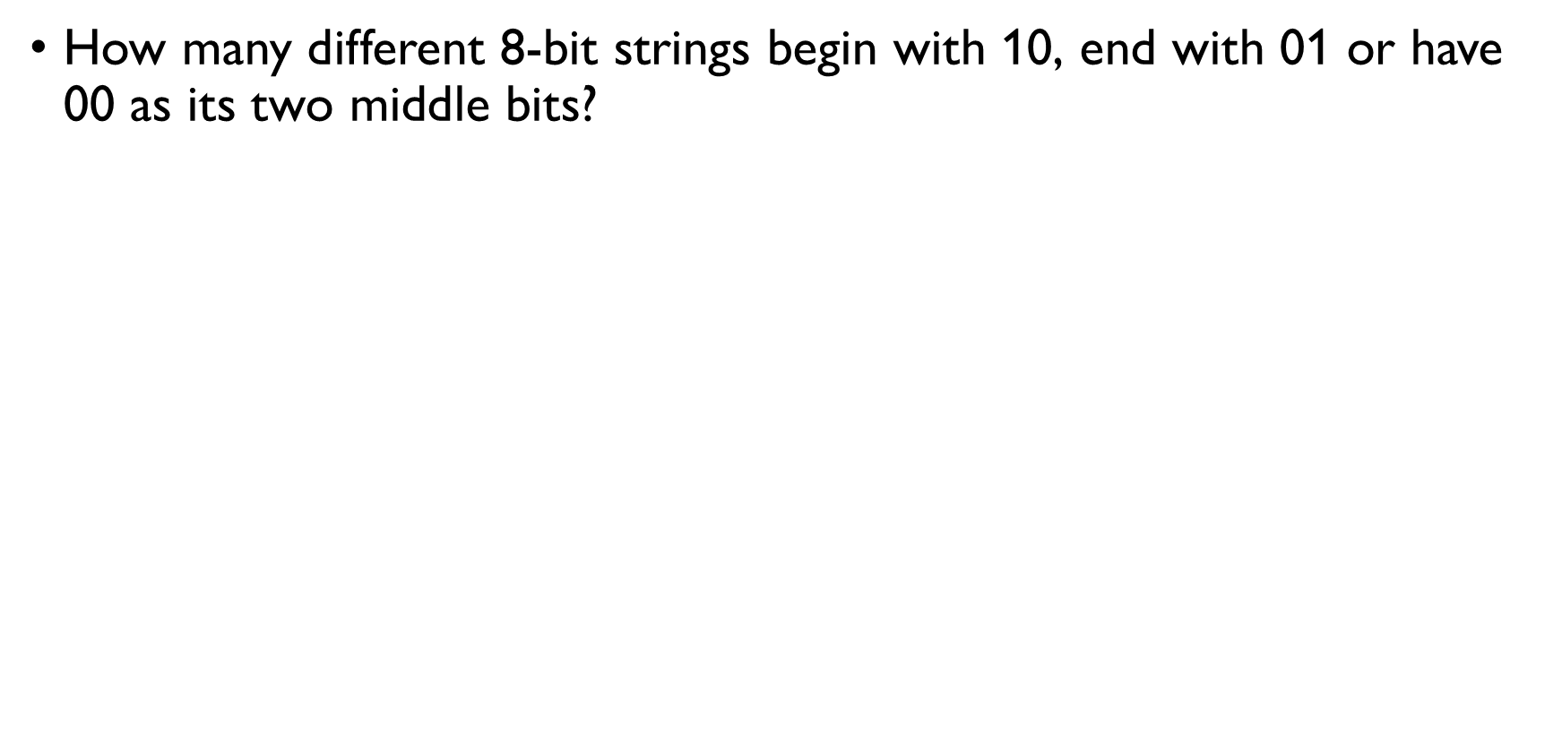
Bit strings
How many different 8-bit strings begin with 10, end with 01 or have 00 as its two middle bits? End begin with 10: $2^{6}$ End with 01: $2^{6}$ Have 00 in the middle: $2^{6}$

Slide 23
Bit strings
How many different 8-bit strings begin with 10, end with 01 or have 00 as its two middle bits? End begin with 10: $2^{6}$ End with 01: $2^{6}$ Have 00 in the middle: $2^{6}$
1 | 0 | * | * | * | * | * | *
* | * | * | * | * | * | 0 | 1
* | * | * | 0 | 0 | * | * | *

Slide 24
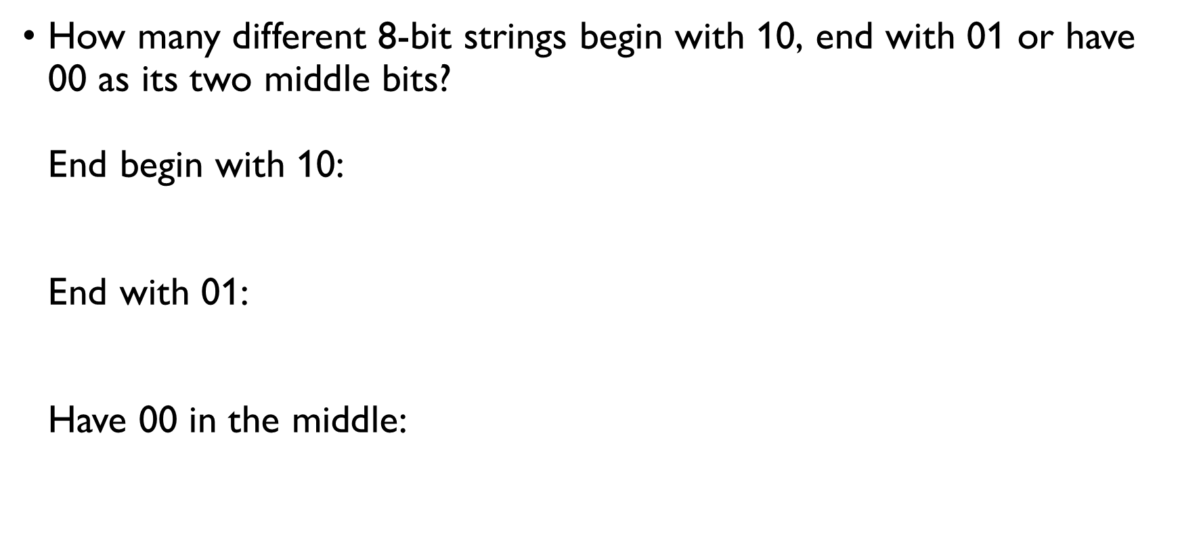
Bit strings
How many different 8-bit strings begin with 10, end with 01 or have 00 as its two middle bits? End begin with 10: $2^{6}$ End with 01: $2^{6}$ Have 00 in the middle: $2^{6}$
1 | 0 | * | * | * | * | * | *
* | * | * | * | * | * | 0 | 1
* | * | * | 0 | 0 | * | * | *

Slide 25
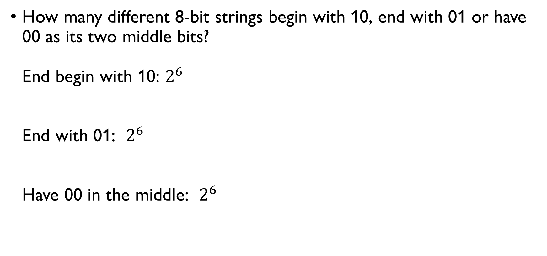
Bit strings
How many different 8-bit strings begin with 10, end with 01 or have 00 as its two middle bits? End begin with 10: $2^{6}$ End with 01: $2^{6}$ Have 00 in the middle: $2^{6}$
1 | 0 | * | * | * | * | * | *
* | * | * | * | * | * | 0 | 1
* | * | * | 0 | 0 | * | * | *

Slide 26
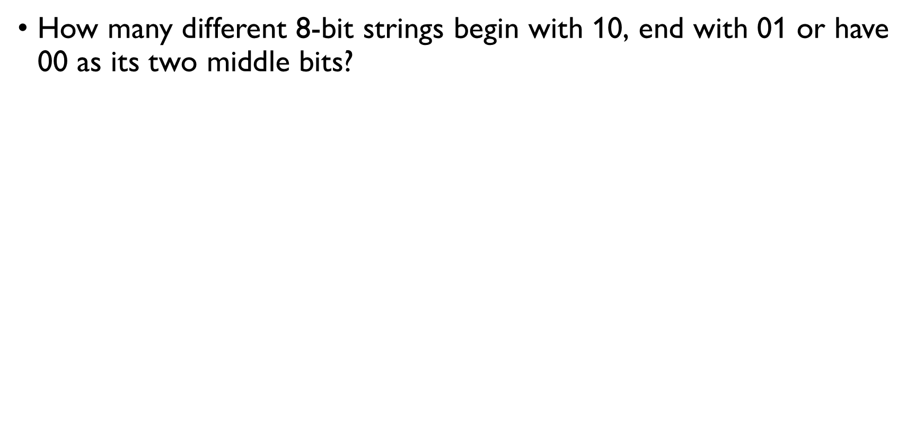
Bit strings
How many different 8-bit strings begin with 10, end with 01 or have 00 as its two middle bits? End begin with 10 and end with 01: $2^{4}$ Begin with 10 and have 00 in the middle: $2^{4}$ Have 00 in the middle and end with 01: $2^{4}$
1 | 0 | * | * | * | * | 0 | 1
1 | 0 | * | 0 | 0 | * | * | *
* | * | * | 0 | 0 | * | 0 | 1

Slide 27
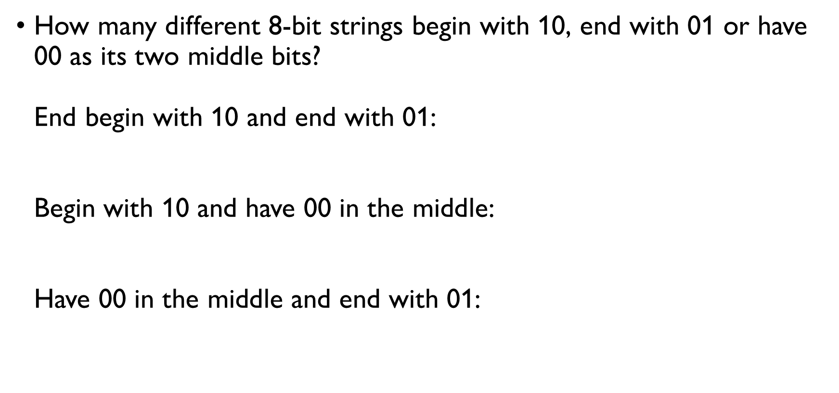
Bit strings
How many different 8-bit strings begin with 10, end with 01 or have 00 as its two middle bits? End begin with 10 and end with 01: $2^{4}$ Begin with 10 and have 00 in the middle: $2^{4}$ Have 00 in the middle and end with 01: $2^{4}$
1 | 0 | * | * | * | * | 0 | 1
1 | 0 | * | 0 | 0 | * | * | *
* | * | * | 0 | 0 | * | 0 | 1

Slide 28
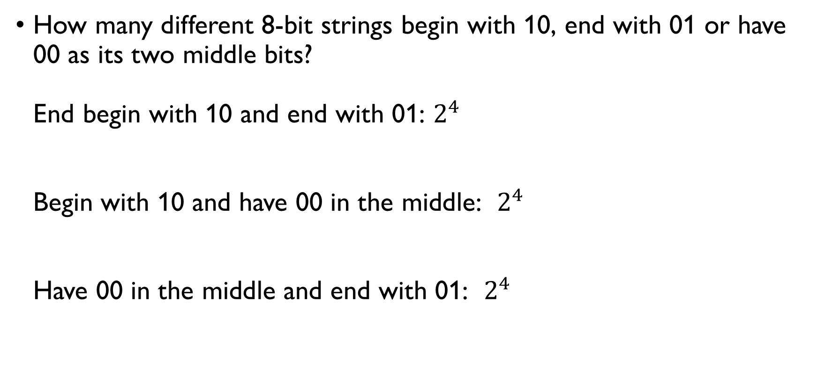
Bit strings
How many different 8-bit strings begin with 10, end with 01 or have 00 as its two middle bits? End begin with 10 and end with 01: $2^{4}$ Begin with 10 and have 00 in the middle: $2^{4}$ Have 00 in the middle and end with 01: $2^{4}$
1 | 0 | * | * | * | * | 0 | 1
1 | 0 | * | 0 | 0 | * | * | *
* | * | * | 0 | 0 | * | 0 | 1

Slide 29
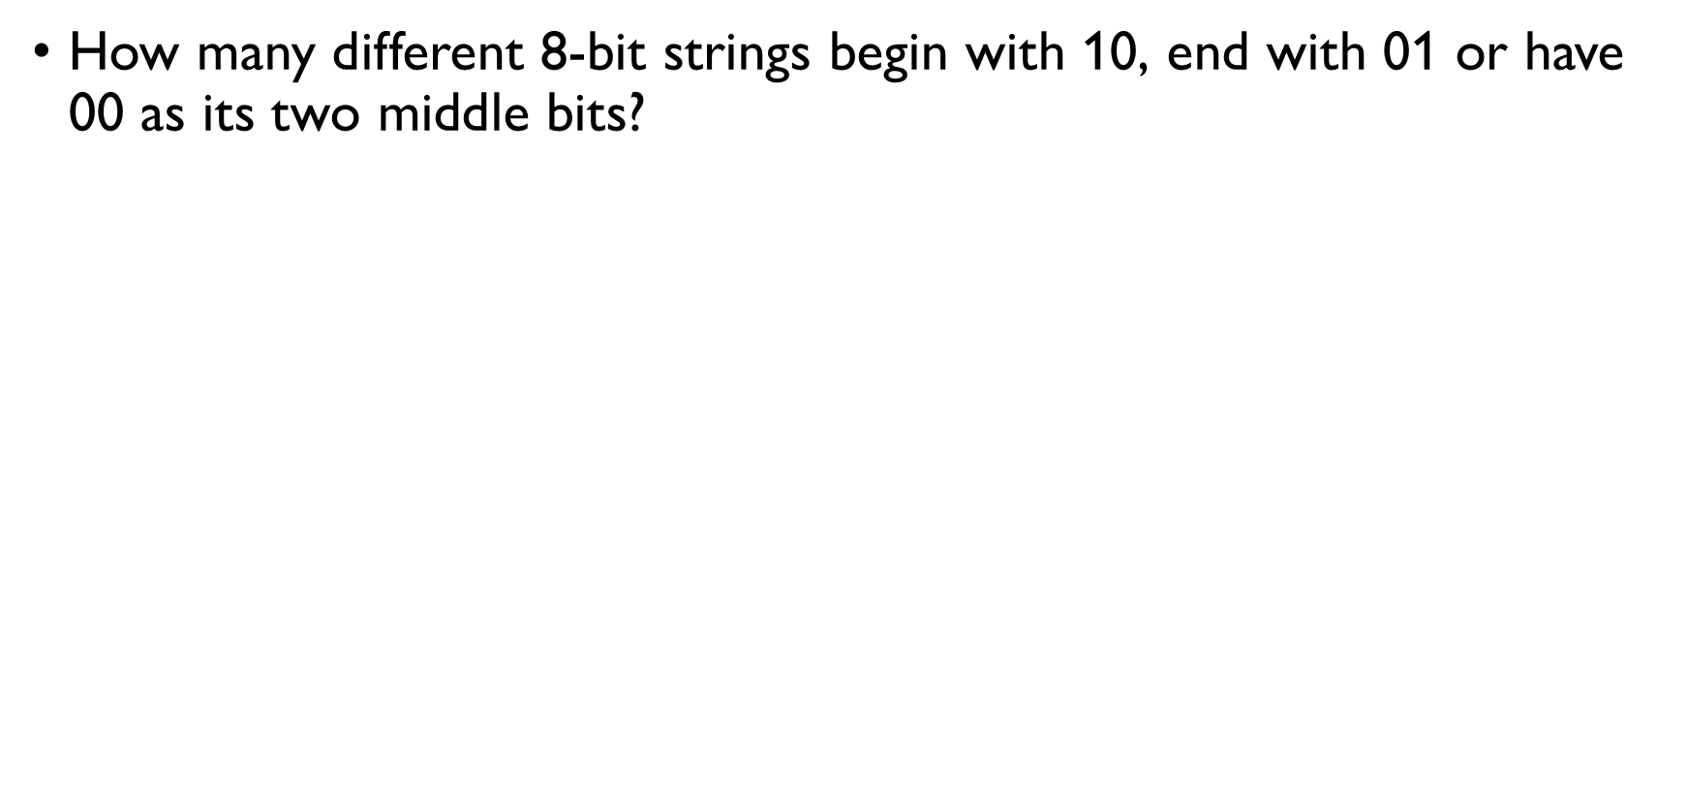
Bit strings
How many different 8-bit strings begin with 10, end with 01 or have 00 as its two middle bits? Begin with 10, have 00 in the middle and end with 01: $2^{2}$ $3⋅2^{6}−3⋅2^{4}+2^{2}=3⋅64−3⋅16+4=148$ 8-bit strings begin with 10, end with 01 or have 00 in the middle
1 | 0 | * | 0 | 0 | * | 0 | 1

Slide 30
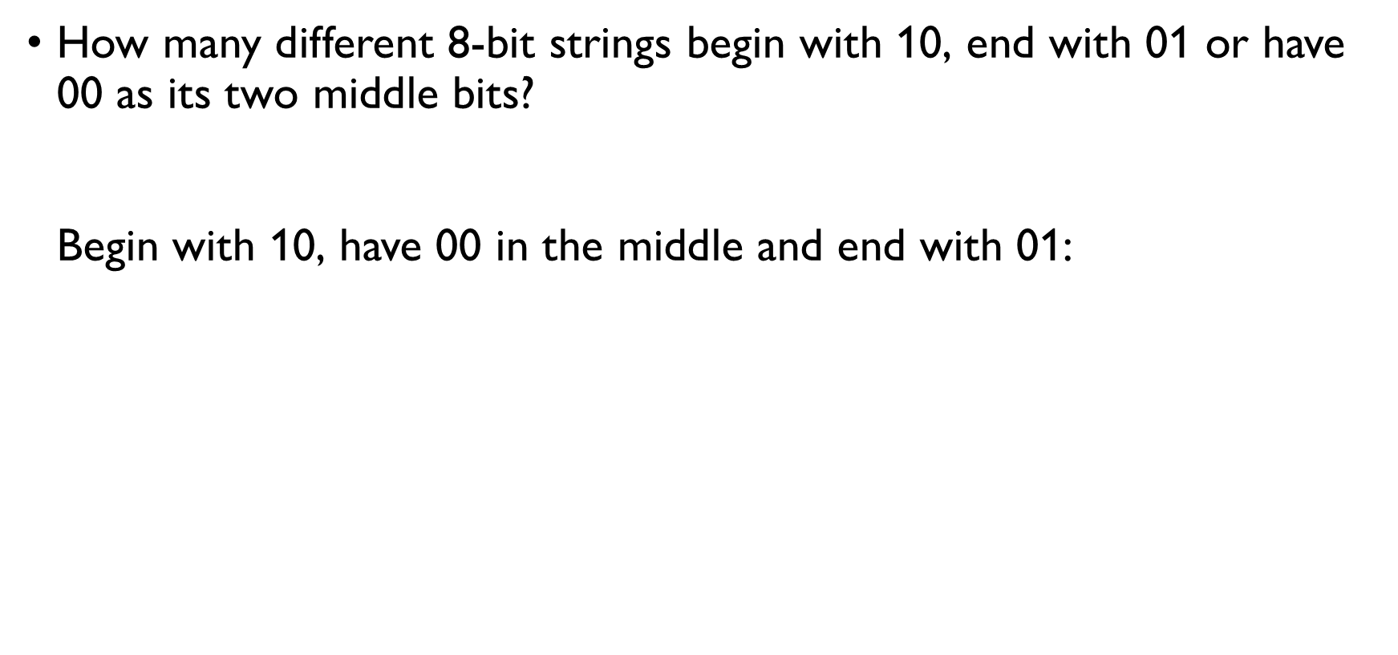
Bit strings
How many different 8-bit strings begin with 10, end with 01 or have 00 as its two middle bits? Begin with 10, have 00 in the middle and end with 01: $2^{2}$ $3⋅2^{6}−3⋅2^{4}+2^{2}=3⋅64−3⋅16+4=148$ 8-bit strings begin with 10, end with 01 or have 00 in the middle
1 | 0 | * | 0 | 0 | * | 0 | 1

Slide 31
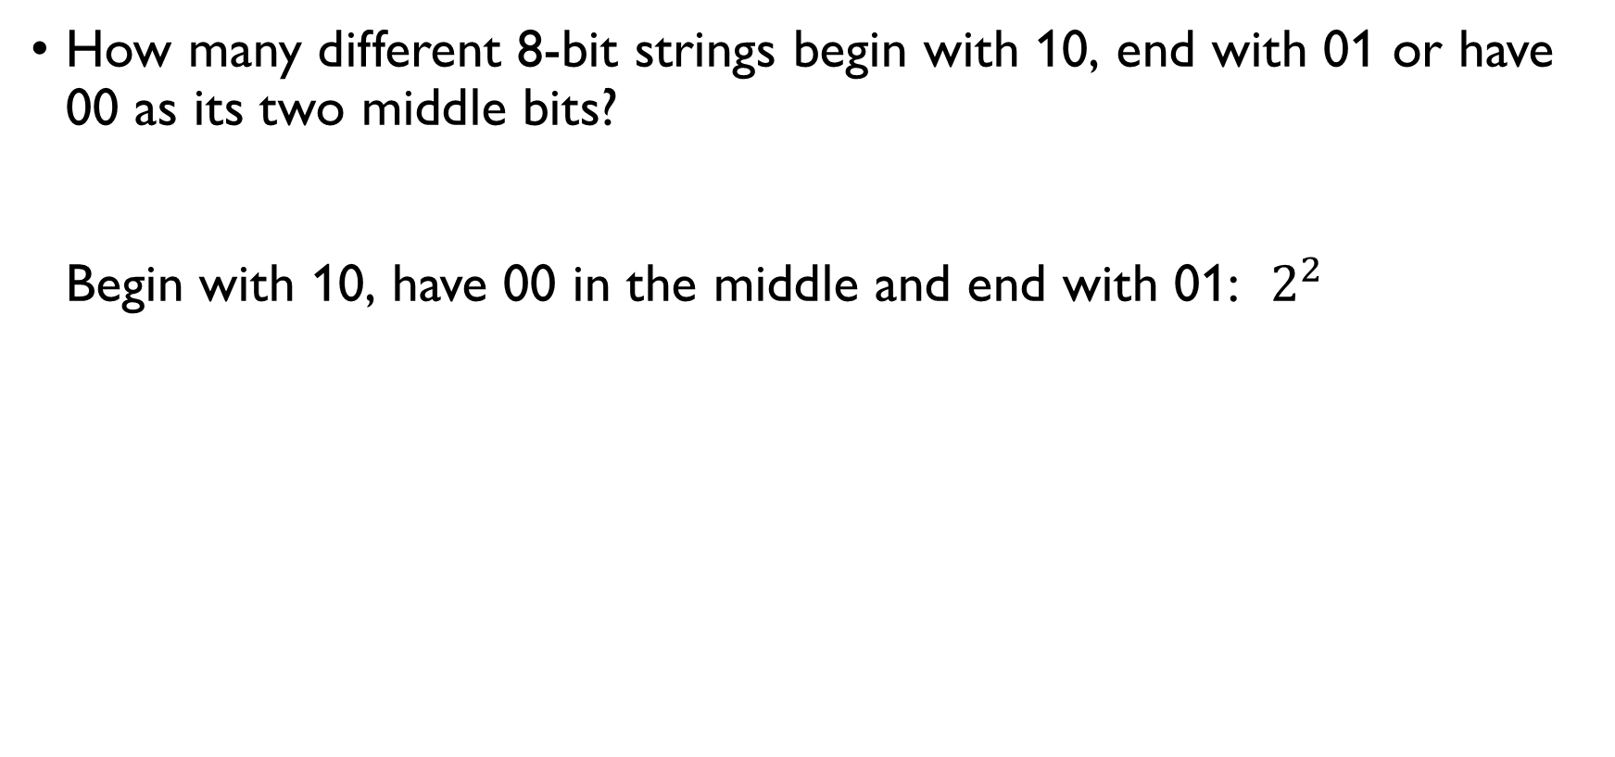
Bit strings
How many different 8-bit strings begin with 10, end with 01 or have 00 as its two middle bits? Begin with 10, have 00 in the middle and end with 01: $2^{2}$ $3⋅2^{6}−3⋅2^{4}+2^{2}=3⋅64−3⋅16+4=148$ 8-bit strings begin with 10, end with 01 or have 00 in the middle
1 | 0 | * | 0 | 0 | * | 0 | 1

Slide 32
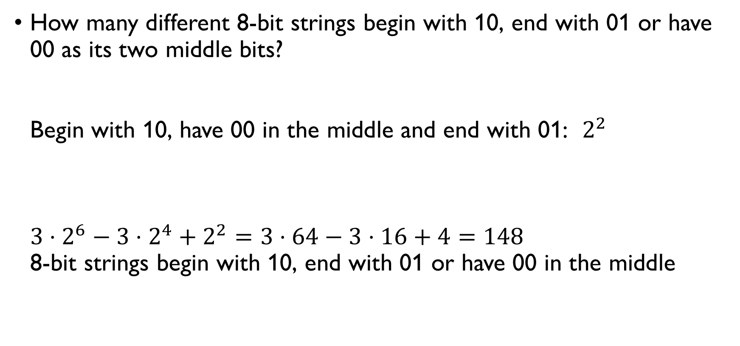
Bit strings
How many different 8-bit strings begin with 10, end with 01 or have 00 as its two middle bits? Begin with 10, have 00 in the middle and end with 01: $2^{2}$ $3⋅2^{6}−3⋅2^{4}+2^{2}=3⋅64−3⋅16+4=148$ 8-bit strings begin with 10, end with 01 or have 00 in the middle
1 | 0 | * | 0 | 0 | * | 0 | 1

Slide 33
COUNTING ARRANGEMENTS

Slide 34
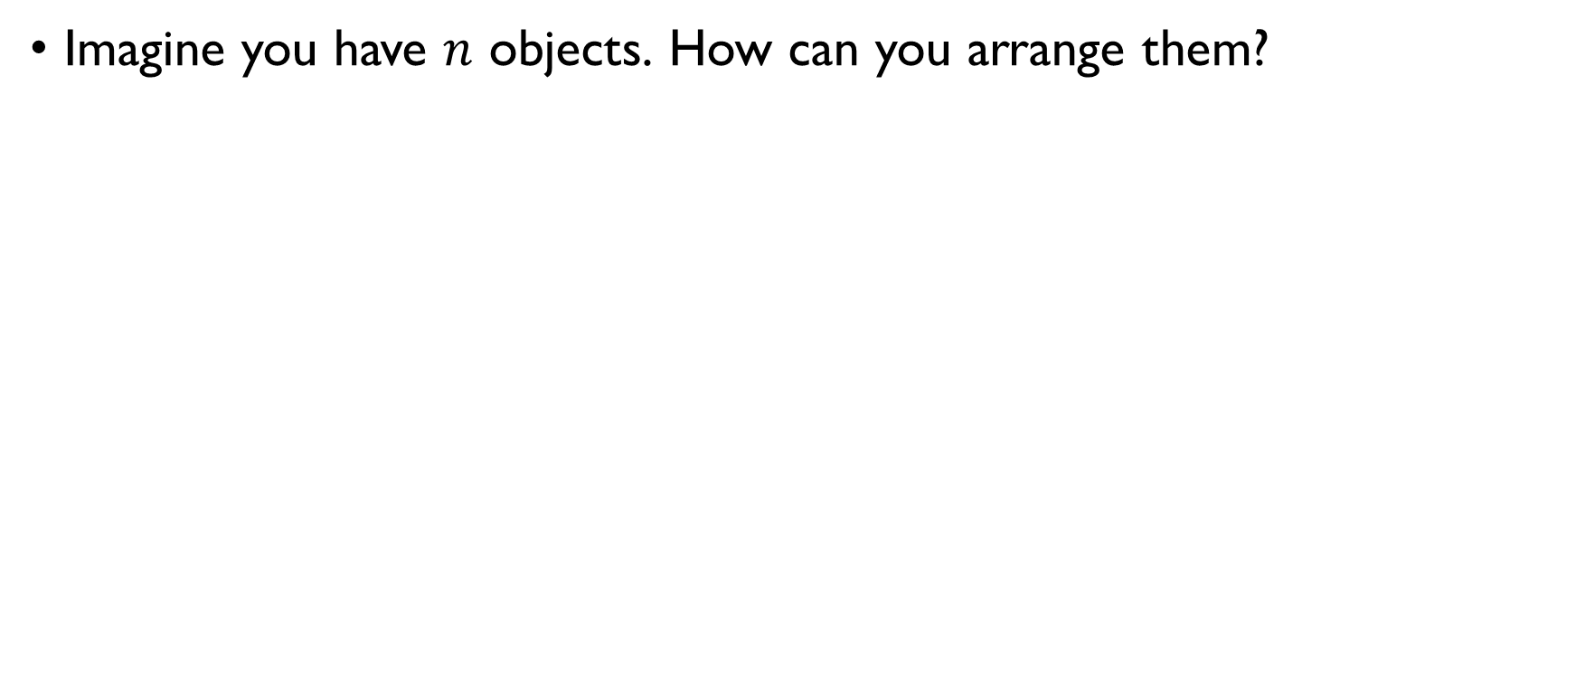
Arrangements of objects
Imagine you have $n$ objects. How can you arrange them?

Slide 35
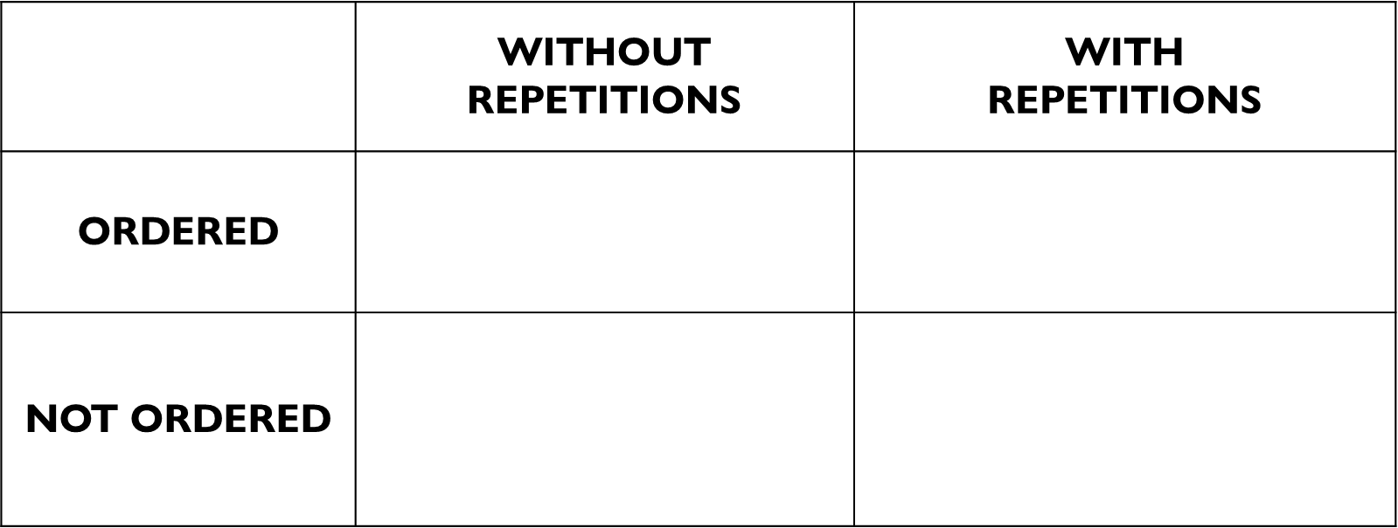
Arrangements of objects
Imagine you have $n$ objects. How can you arrange them?
 | WITHOUT REPETITIONS | WITH REPETITIONS
ORDERED | In how many ways can $n$ people sit in a row? | How many different $n$-bit strings are there?
NOT ORDERED | In how many ways can we chose $k$ out of $n$ different candies in a bag? | In how many ways can we distribute $n$ identical candies among k kids?

Slide 36
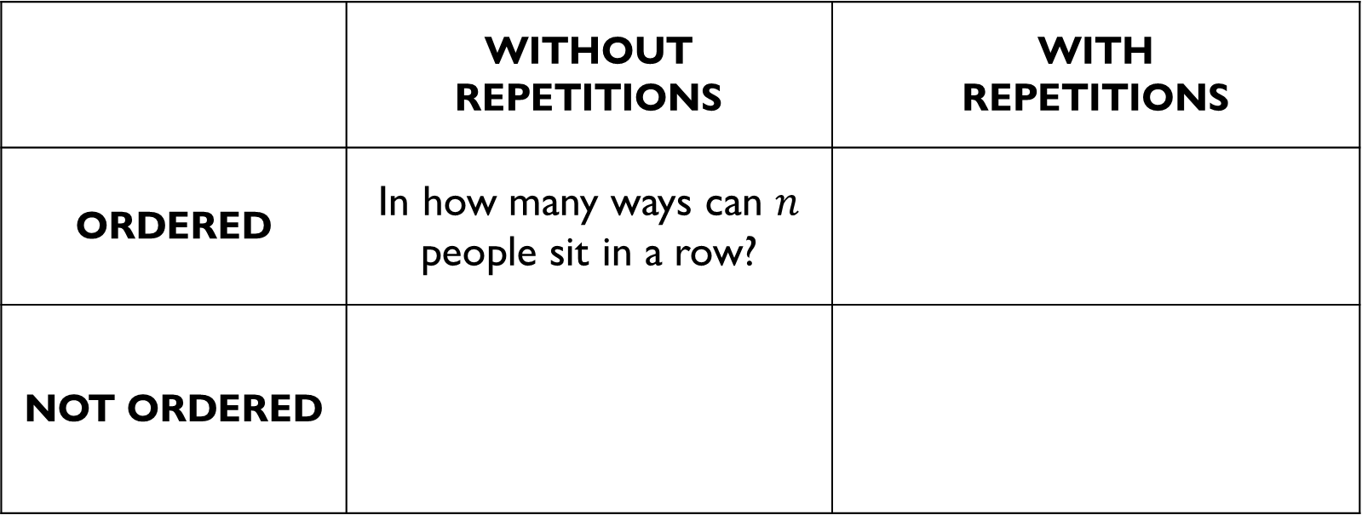
Arrangements of objects
Imagine you have $n$ objects. How can you arrange them?
 | WITHOUT REPETITIONS | WITH REPETITIONS
ORDERED | In how many ways can $n$ people sit in a row? | How many different $n$-bit strings are there?
NOT ORDERED | In how many ways can we chose $k$ out of $n$ different candies in a bag? | In how many ways can we distribute $n$ identical candies among k kids?

Slide 37
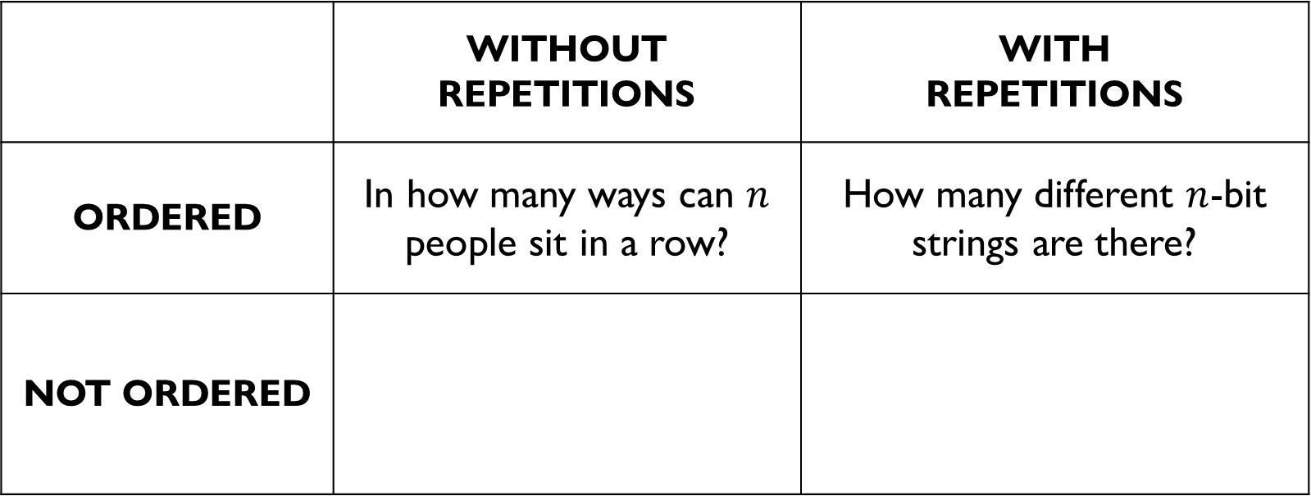
Arrangements of objects
Imagine you have $n$ objects. How can you arrange them?
 | WITHOUT REPETITIONS | WITH REPETITIONS
ORDERED | In how many ways can $n$ people sit in a row? | How many different $n$-bit strings are there?
NOT ORDERED | In how many ways can we chose $k$ out of $n$ different candies in a bag? | In how many ways can we distribute $n$ identical candies among k kids?

Slide 38
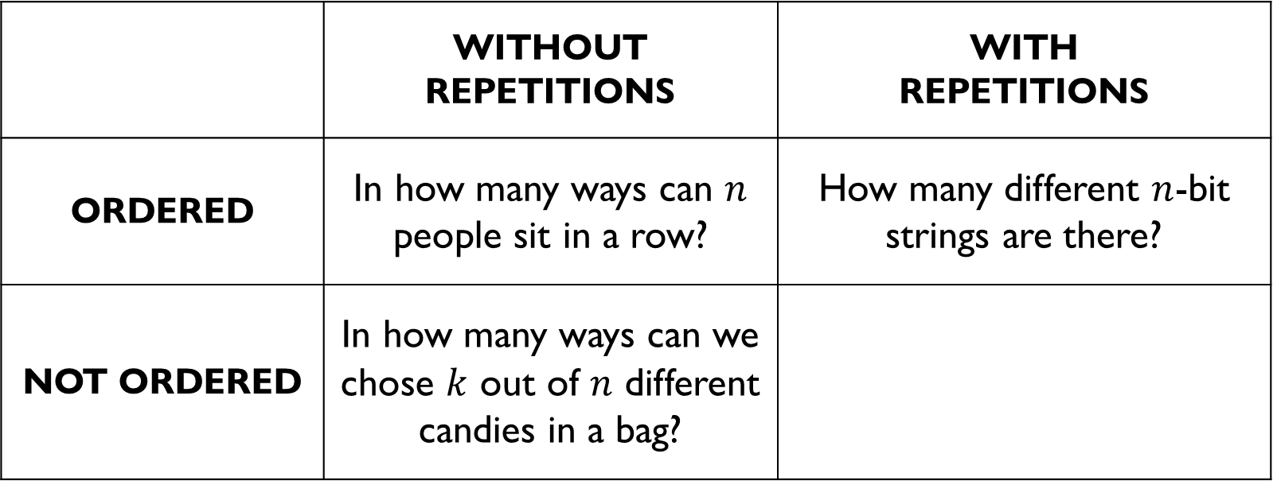
Arrangements of objects
Imagine you have $n$ objects. How can you arrange them?
 | WITHOUT REPETITIONS | WITH REPETITIONS
ORDERED | In how many ways can $n$ people sit in a row? | How many different $n$-bit strings are there?
NOT ORDERED | In how many ways can we chose $k$ out of $n$ different candies in a bag? | In how many ways can we distribute $n$ identical candies among k kids?

Slide 39
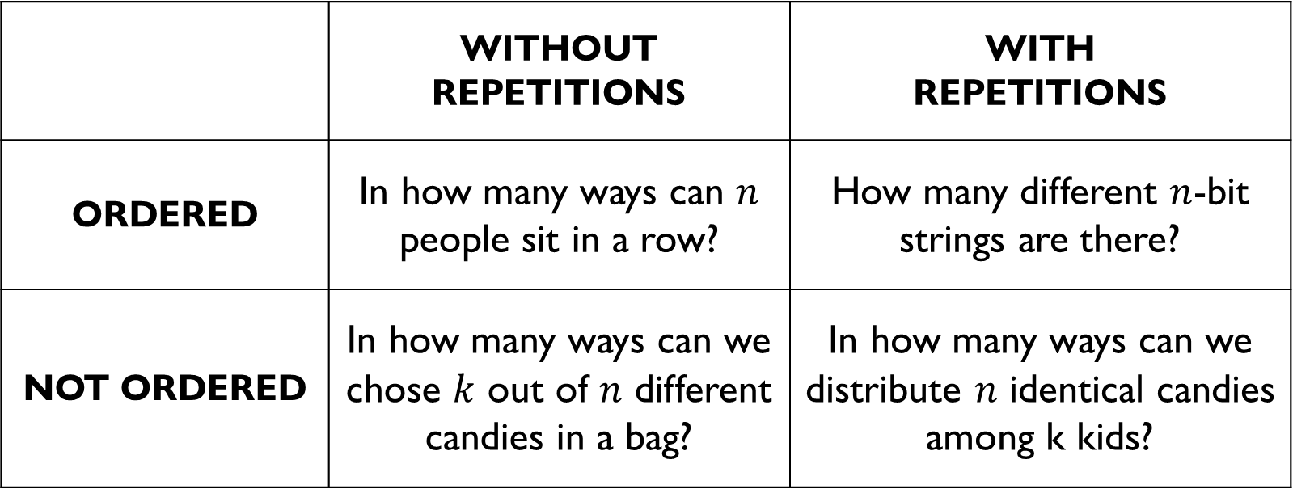
Arrangements of objects
Imagine you have $n$ objects. How can you arrange them?
 | WITHOUT REPETITIONS | WITH REPETITIONS
ORDERED | In how many ways can $n$ people sit in a row? | How many different $n$-bit strings are there?
NOT ORDERED | In how many ways can we chose $k$ out of $n$ different candies in a bag? | In how many ways can we distribute $n$ identical candies among k kids?

Slide 40
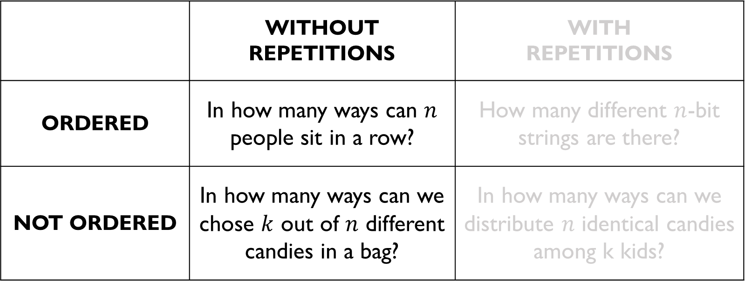
Arrangements of objects
Imagine you have $n$ objects. How can you arrange them?
 | WITHOUT REPETITIONS | WITH REPETITIONS
ORDERED | In how many ways can $n$ people sit in a row? | How many different $n$-bit strings are there?
NOT ORDERED | In how many ways can we chose $k$ out of $n$ different candies in a bag? | In how many ways can we distribute $n$ identical candies among k kids?

Slide 41
PERMUTATIONS
https://youtu.be/uNS1QvDzCVw

Slide 42
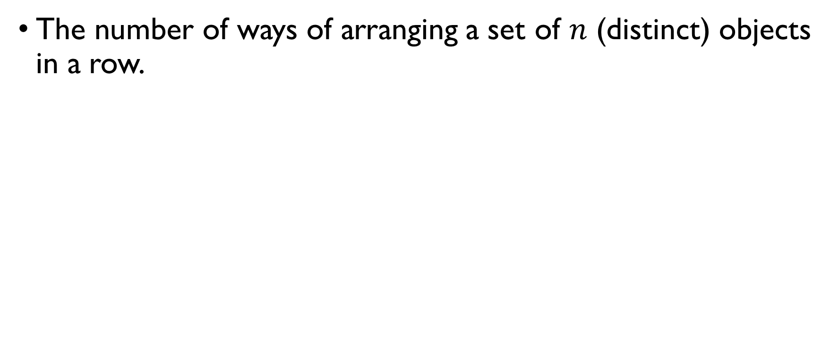
permutations
The number of ways of arranging a set of $n$ (distinct) objects in a row.
We use permutations when we care about order. Example: In how many ways can three runners, $a$, $b$ and $c$, finish the race, if no ties are allowed?

Slide 43
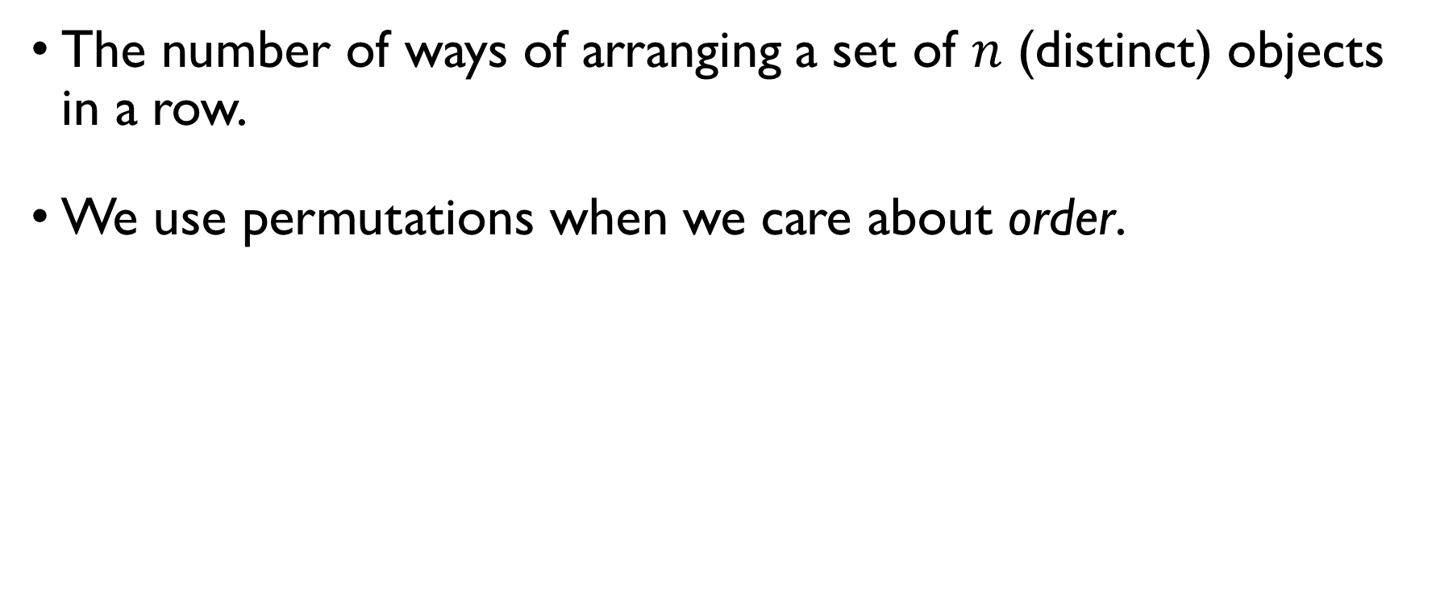
permutations
The number of ways of arranging a set of $n$ (distinct) objects in a row.
We use permutations when we care about order. Example: In how many ways can three runners, $a$, $b$ and $c$, finish the race, if no ties are allowed?

Slide 44
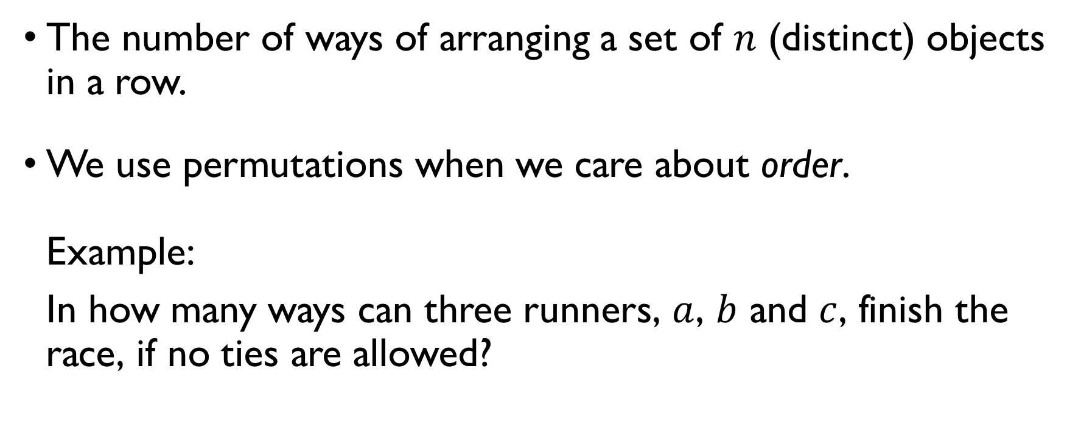
permutations
The number of ways of arranging a set of $n$ (distinct) objects in a row.
We use permutations when we care about order. Example: In how many ways can three runners, $a$, $b$ and $c$, finish the race, if no ties are allowed?

Slide 45
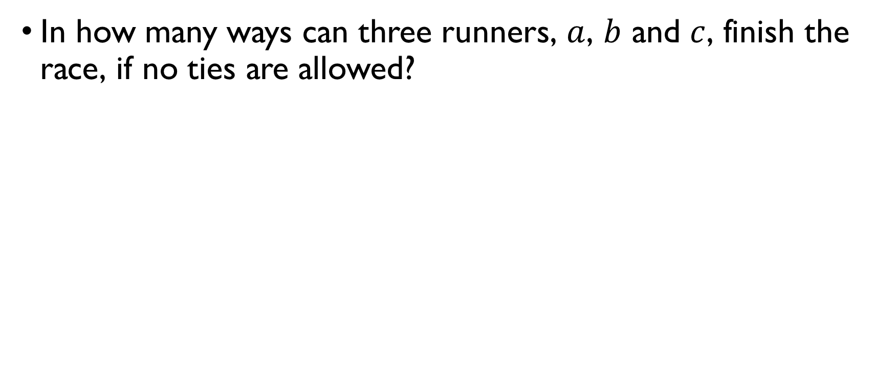
Example: runners
In how many ways can three runners, $a$, $b$ and $c$, finish the race, if no ties are allowed?
abc bac cab
acb bca cba
There are 6 permutations.

Slide 46
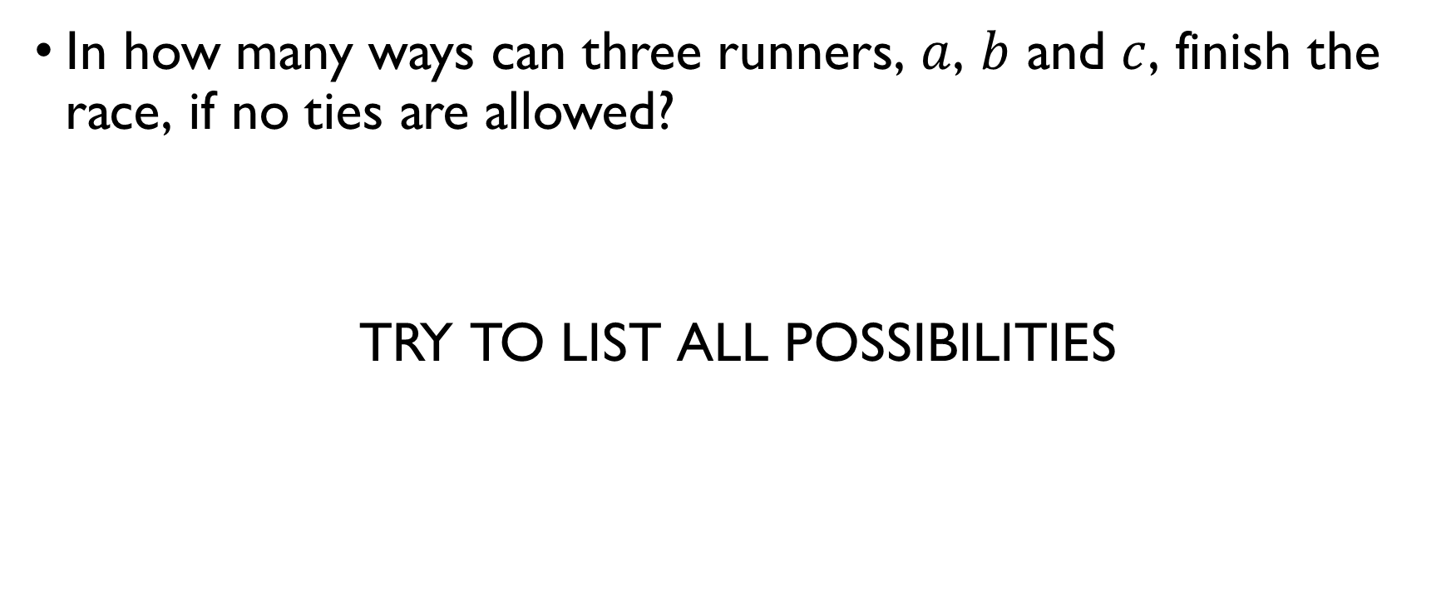
Example: runners
In how many ways can three runners, $a$, $b$ and $c$, finish the race, if no ties are allowed?
TRY TO LIST ALL Possibilities
There are 6 permutations.

Slide 47
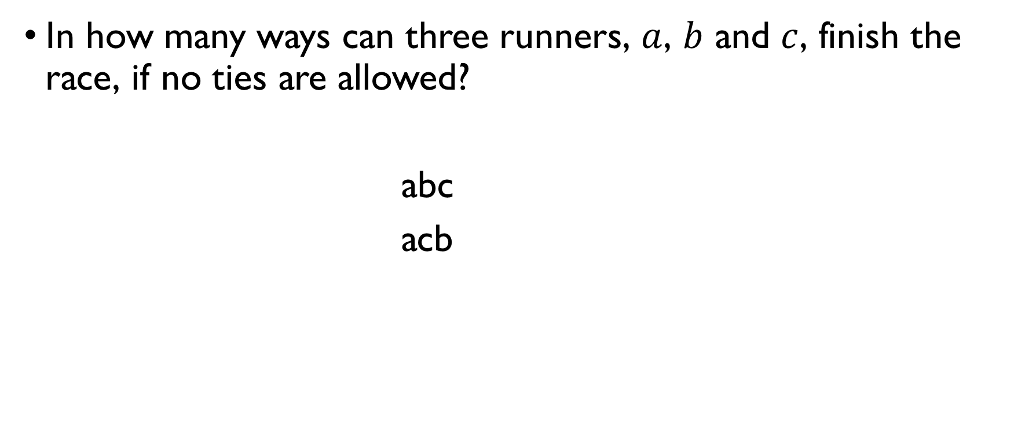
Example: runners
In how many ways can three runners, $a$, $b$ and $c$, finish the race, if no ties are allowed?
abc bac cab
acb bca cba
There are 6 permutations.

Slide 48
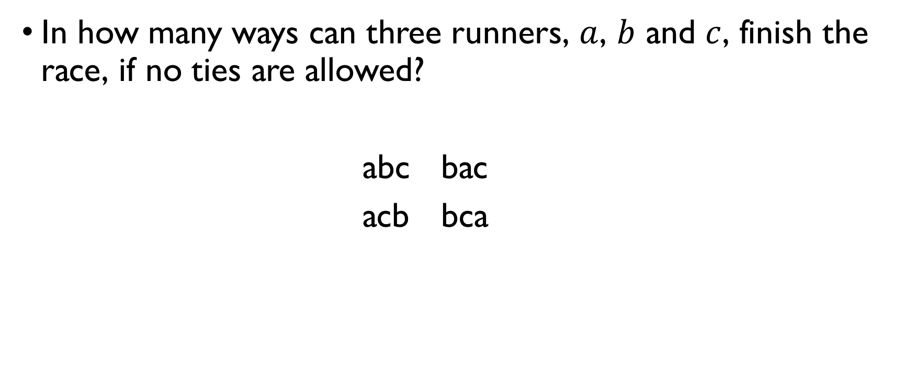
Example: runners
In how many ways can three runners, $a$, $b$ and $c$, finish the race, if no ties are allowed?
abc bac cab
acb bca cba
There are 6 permutations.

Slide 49

Example: runners
In how many ways can three runners, $a$, $b$ and $c$, finish the race, if no ties are allowed?
abc bac cab
acb bca cba
There are 6 permutations.

Slide 50
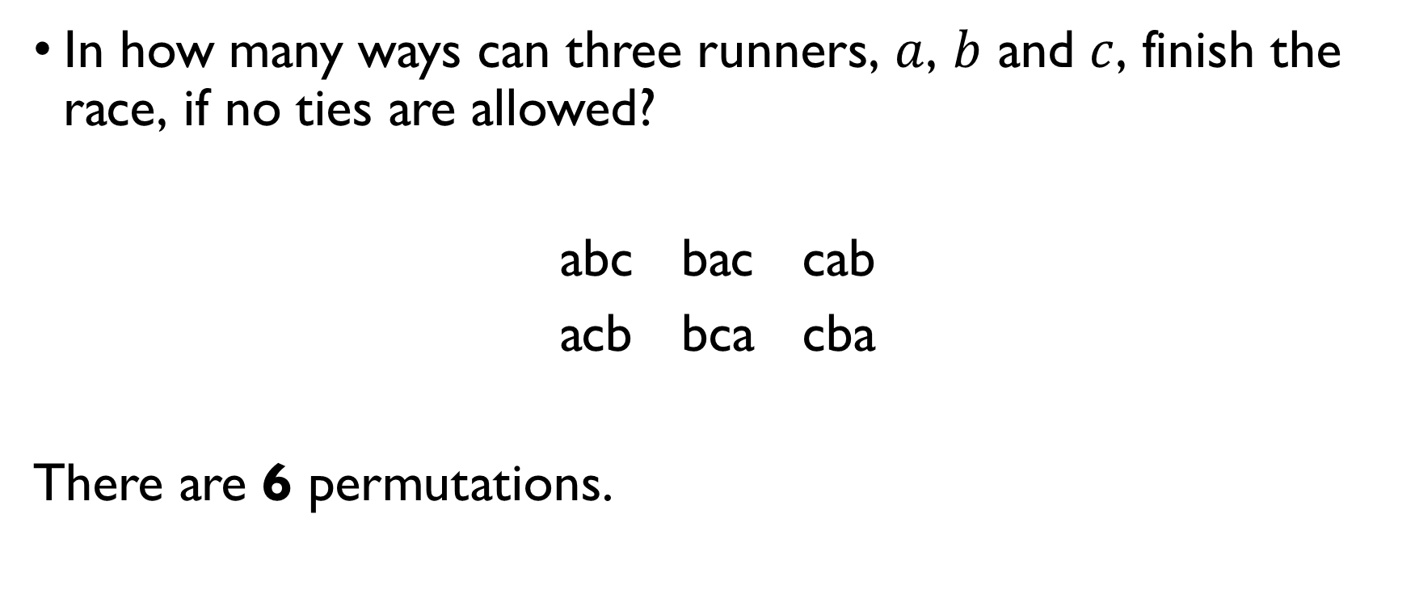
Example: runners
In how many ways can three runners, $a$, $b$ and $c$, finish the race, if no ties are allowed?
abc bac cab
acb bca cba
There are 6 permutations.

Slide 51
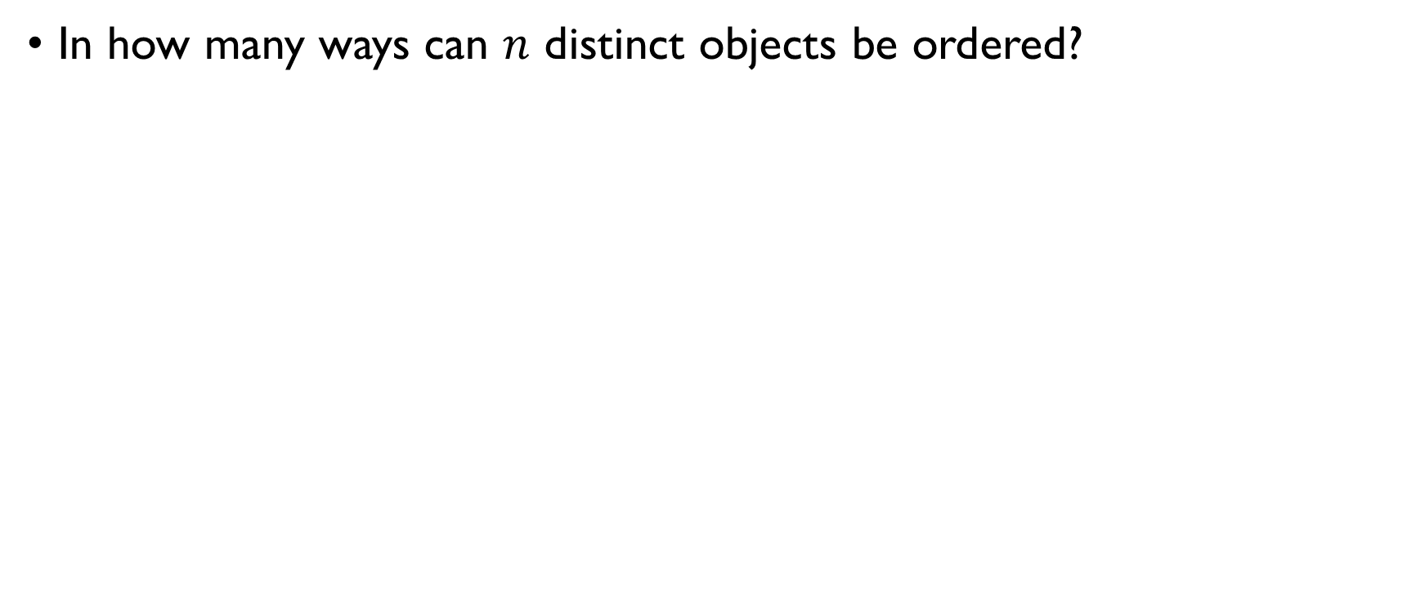

Permutations of $n$ elements
In how many ways can $n$ distinct objects be ordered? Example: In how many orders can we put n books on the shelf?
$$n⋅\left(n−1\right)⋅\left(n−2\right)⋅…⋅3⋅2⋅1$$

Slide 52
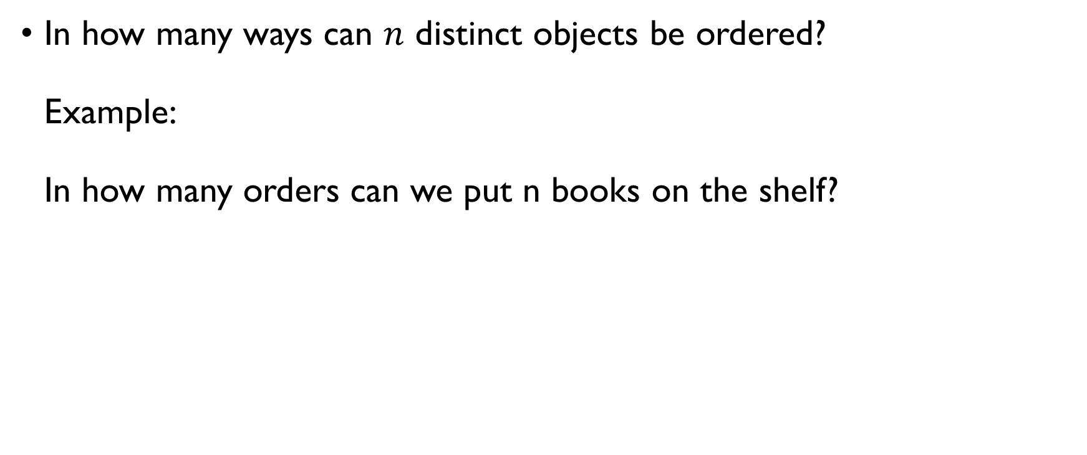
Permutations of $n$ elements
In how many ways can $n$ distinct objects be ordered? Example: In how many orders can we put n books on the shelf?
$$n⋅\left(n−1\right)⋅\left(n−2\right)⋅…⋅3⋅2⋅1$$

Slide 53
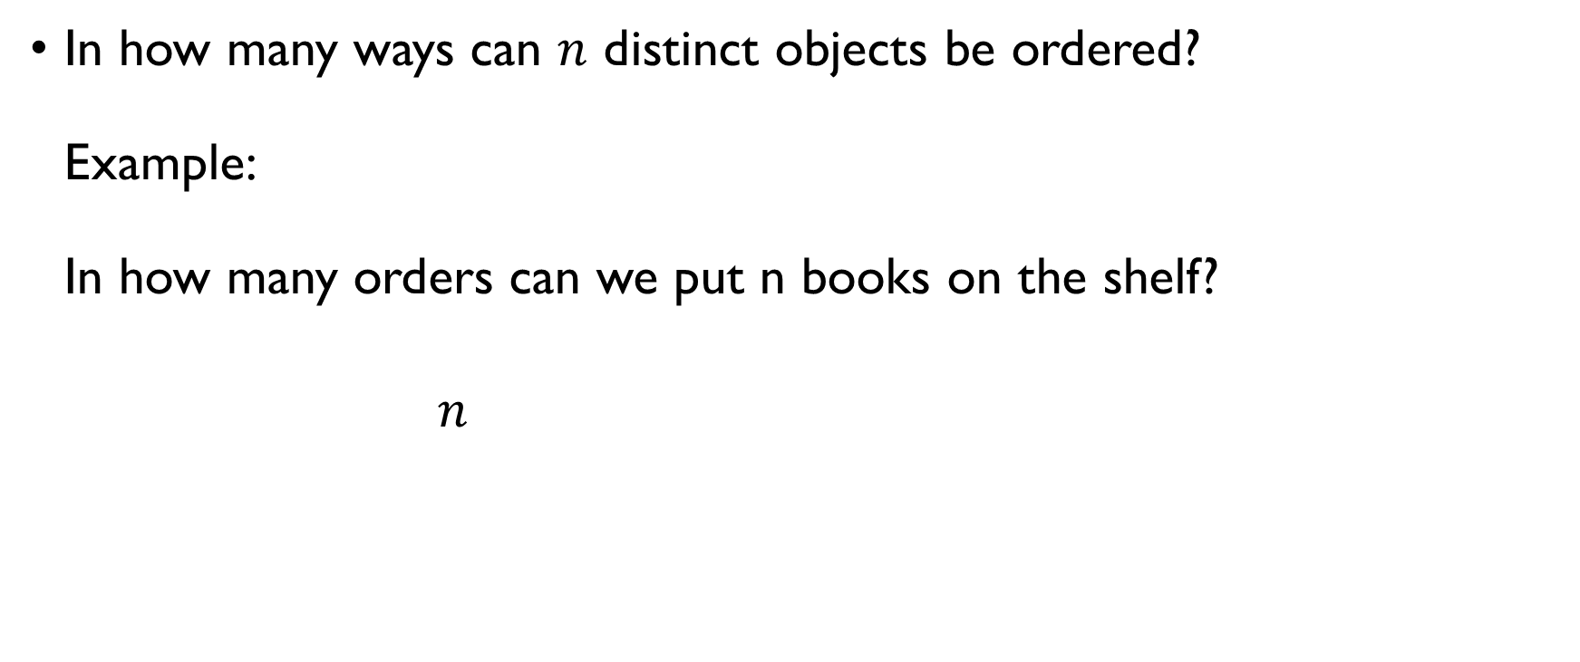
Permutations of $n$ elements
In how many ways can $n$ distinct objects be ordered? Example: In how many orders can we put n books on the shelf?
$$n⋅\left(n−1\right)⋅\left(n−2\right)⋅…⋅3⋅2⋅1$$

Slide 54
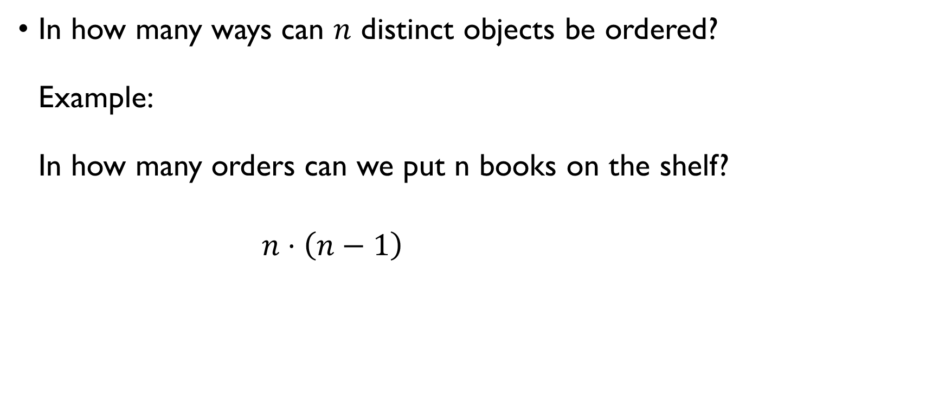
Permutations of $n$ elements
In how many ways can $n$ distinct objects be ordered? Example: In how many orders can we put n books on the shelf?
$$n⋅\left(n−1\right)⋅\left(n−2\right)⋅…⋅3⋅2⋅1$$

Slide 55
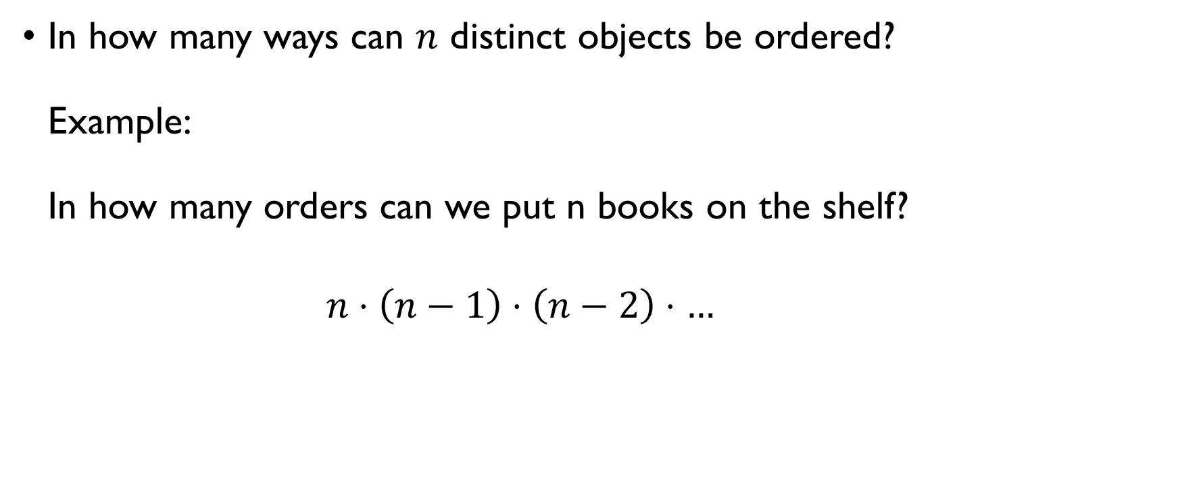
Permutations of $n$ elements
In how many ways can $n$ distinct objects be ordered? Example: In how many orders can we put n books on the shelf?
$$n⋅\left(n−1\right)⋅\left(n−2\right)⋅…⋅3⋅2⋅1$$

Slide 56
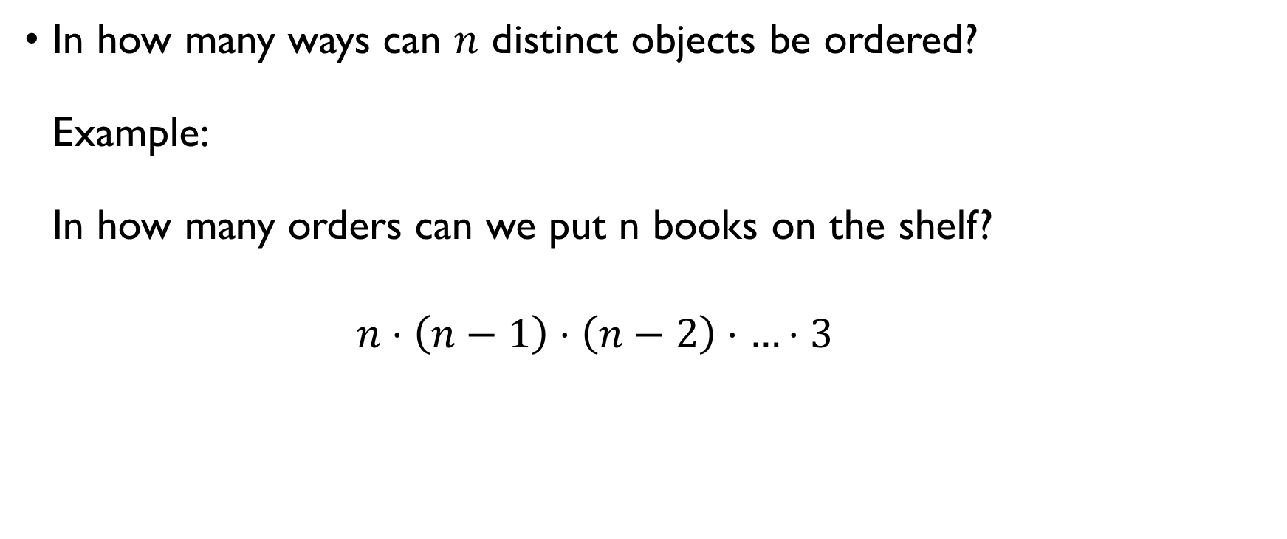
Permutations of $n$ elements
In how many ways can $n$ distinct objects be ordered? Example: In how many orders can we put n books on the shelf?
$$n⋅\left(n−1\right)⋅\left(n−2\right)⋅…⋅3⋅2⋅1$$

Slide 57
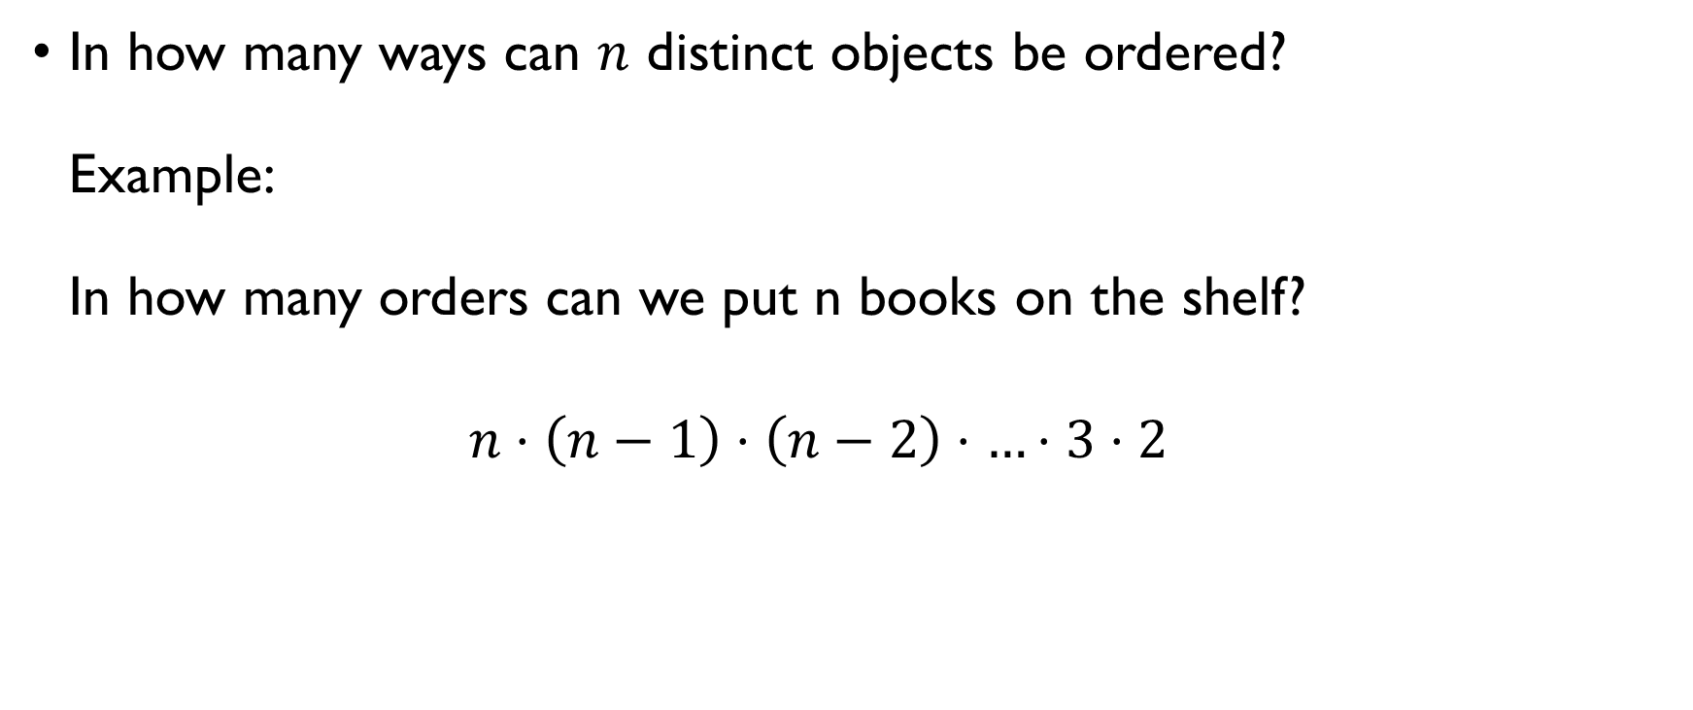
Permutations of $n$ elements
In how many ways can $n$ distinct objects be ordered? Example: In how many orders can we put n books on the shelf?
$$n⋅\left(n−1\right)⋅\left(n−2\right)⋅…⋅3⋅2⋅1$$

Slide 58
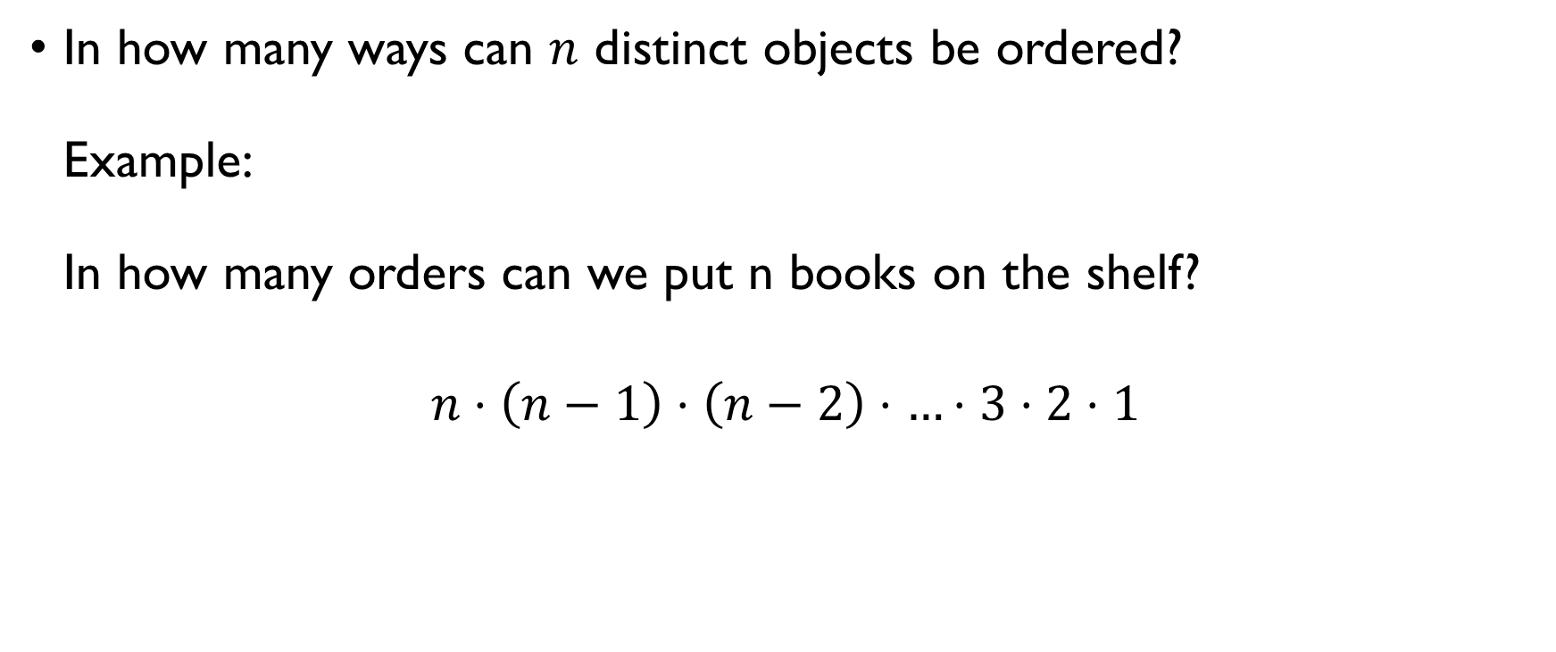
Permutations of $n$ elements
In how many ways can $n$ distinct objects be ordered? Example: In how many orders can we put n books on the shelf?
$$n⋅\left(n−1\right)⋅\left(n−2\right)⋅…⋅3⋅2⋅1$$

Slide 59
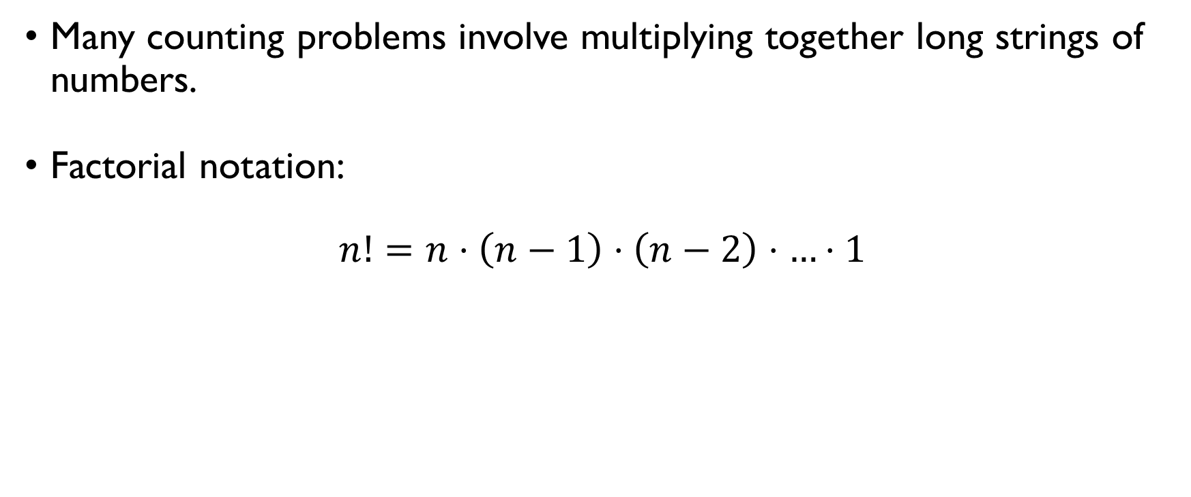
FACTORIAL
Many counting problems involve multiplying together long strings of numbers.
Factorial notation:
$n!=n⋅\left(n−1\right)⋅\left(n−2\right)⋅…⋅1$
Examples:
$3!=3⋅2⋅1=6$ $5!=5⋅4⋅3⋅2⋅1=120$ $0!=1$

Slide 60
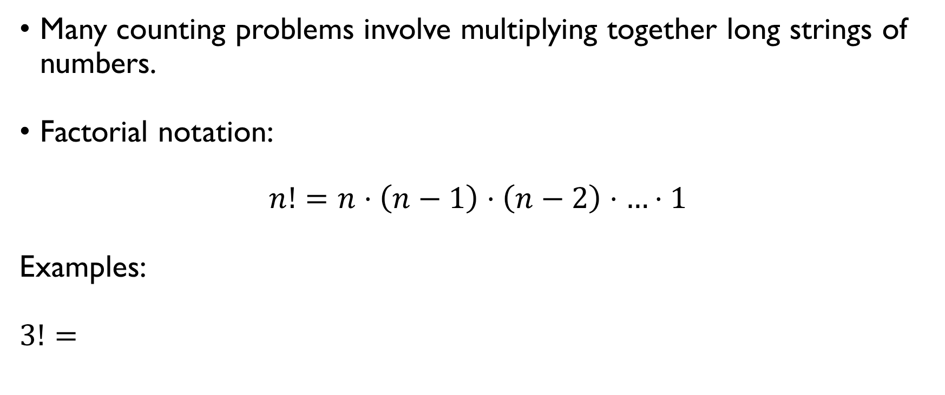
FACTORIAL
Many counting problems involve multiplying together long strings of numbers.
Factorial notation:
$n!=n⋅\left(n−1\right)⋅\left(n−2\right)⋅…⋅1$
Examples:
$3!=3⋅2⋅1=6$ $5!=5⋅4⋅3⋅2⋅1=120$ $0!=1$

Slide 61
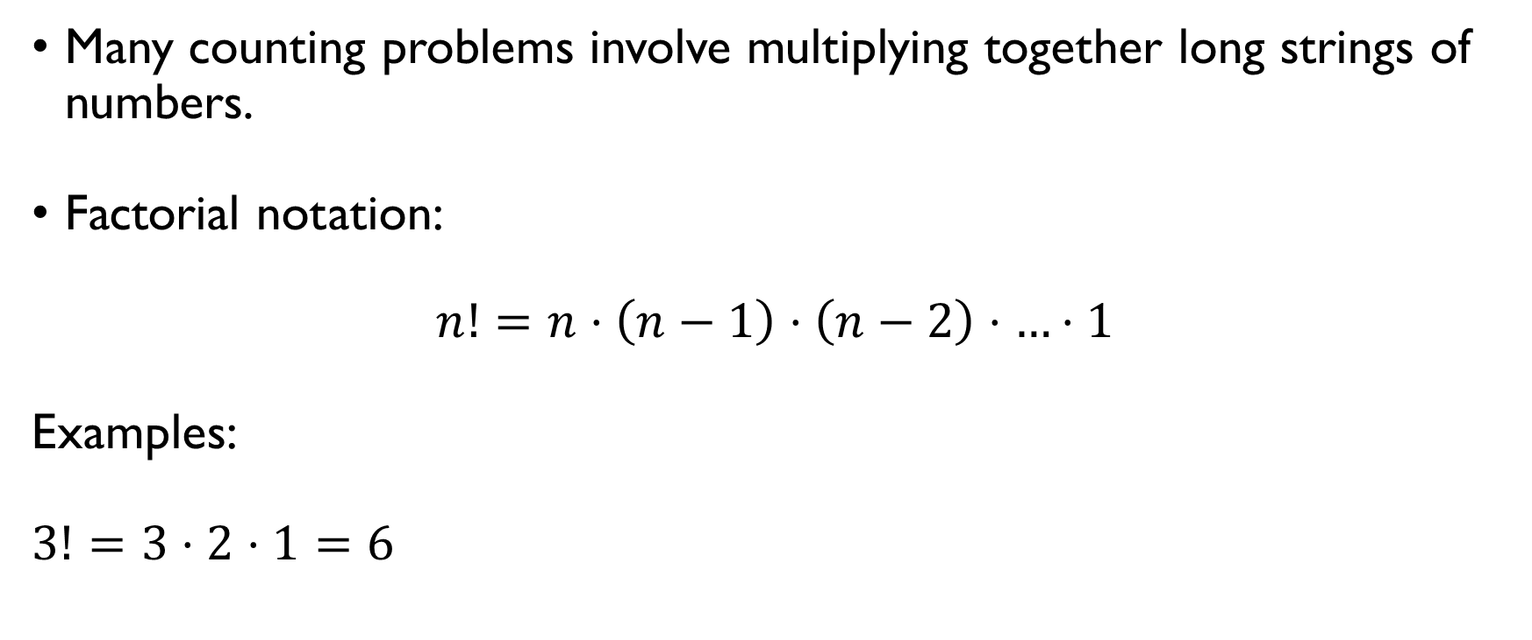
FACTORIAL
Many counting problems involve multiplying together long strings of numbers.
Factorial notation:
$n!=n⋅\left(n−1\right)⋅\left(n−2\right)⋅…⋅1$
Examples:
$3!=3⋅2⋅1=6$ $5!=5⋅4⋅3⋅2⋅1=120$ $0!=1$

Slide 62
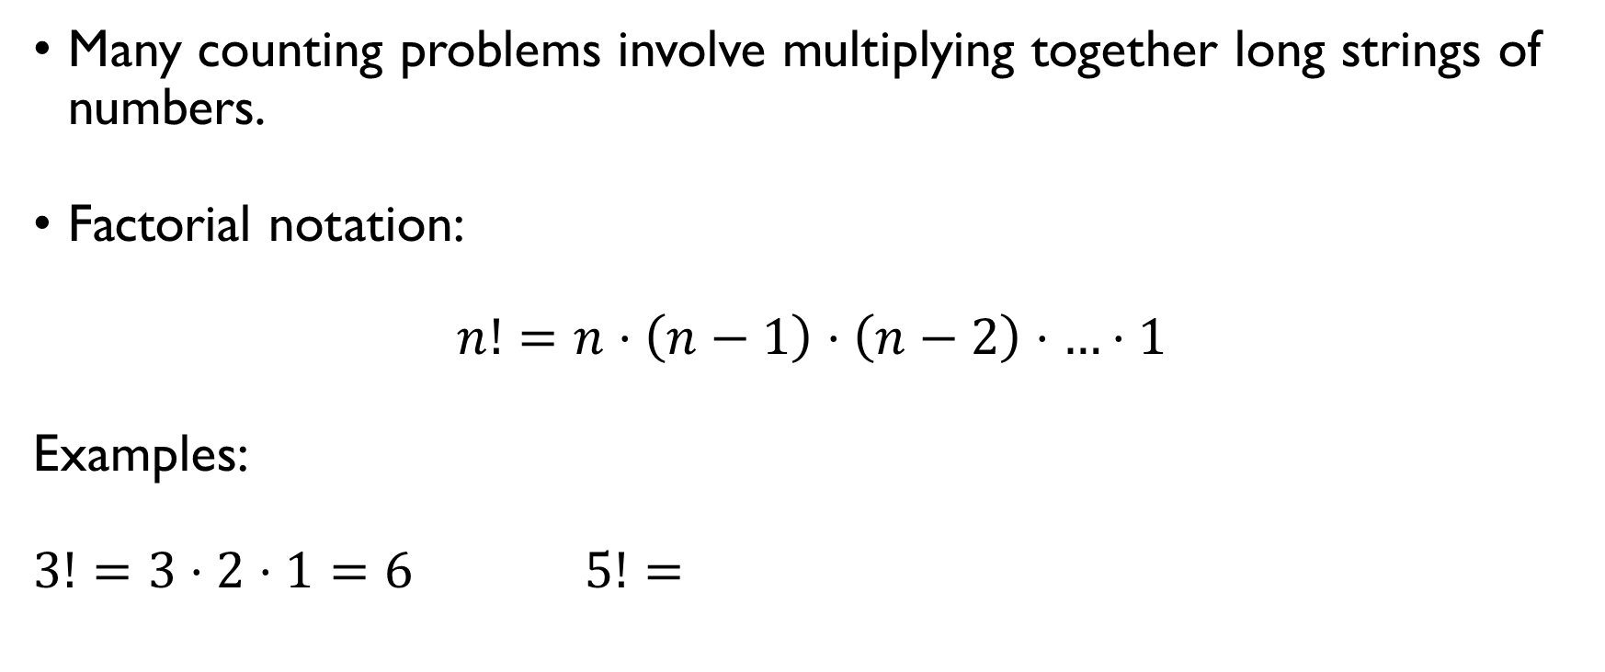
FACTORIAL
Many counting problems involve multiplying together long strings of numbers.
Factorial notation:
$n!=n⋅\left(n−1\right)⋅\left(n−2\right)⋅…⋅1$
Examples:
$3!=3⋅2⋅1=6$ $5!=5⋅4⋅3⋅2⋅1=120$ $0!=1$

Slide 63
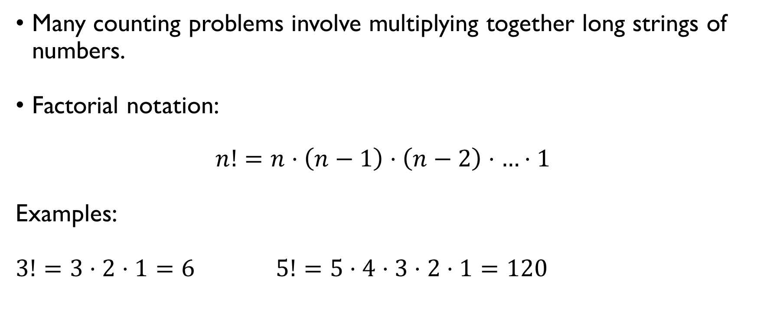
FACTORIAL
Many counting problems involve multiplying together long strings of numbers.
Factorial notation:
$n!=n⋅\left(n−1\right)⋅\left(n−2\right)⋅…⋅1$
Examples:
$3!=3⋅2⋅1=6$ $5!=5⋅4⋅3⋅2⋅1=120$ $0!=1$

Slide 64
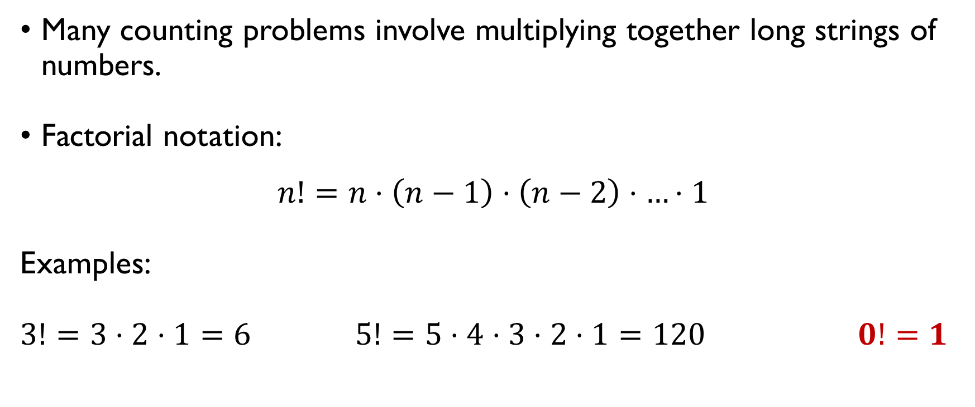
FACTORIAL
Many counting problems involve multiplying together long strings of numbers.
Factorial notation:
$$n!=n⋅\left(n−1\right)⋅\left(n−2\right)⋅…⋅1$$
Examples:
$3!=3⋅2⋅1=6$ $5!=5⋅4⋅3⋅2⋅1=120$ $0!=1$

Slide 65
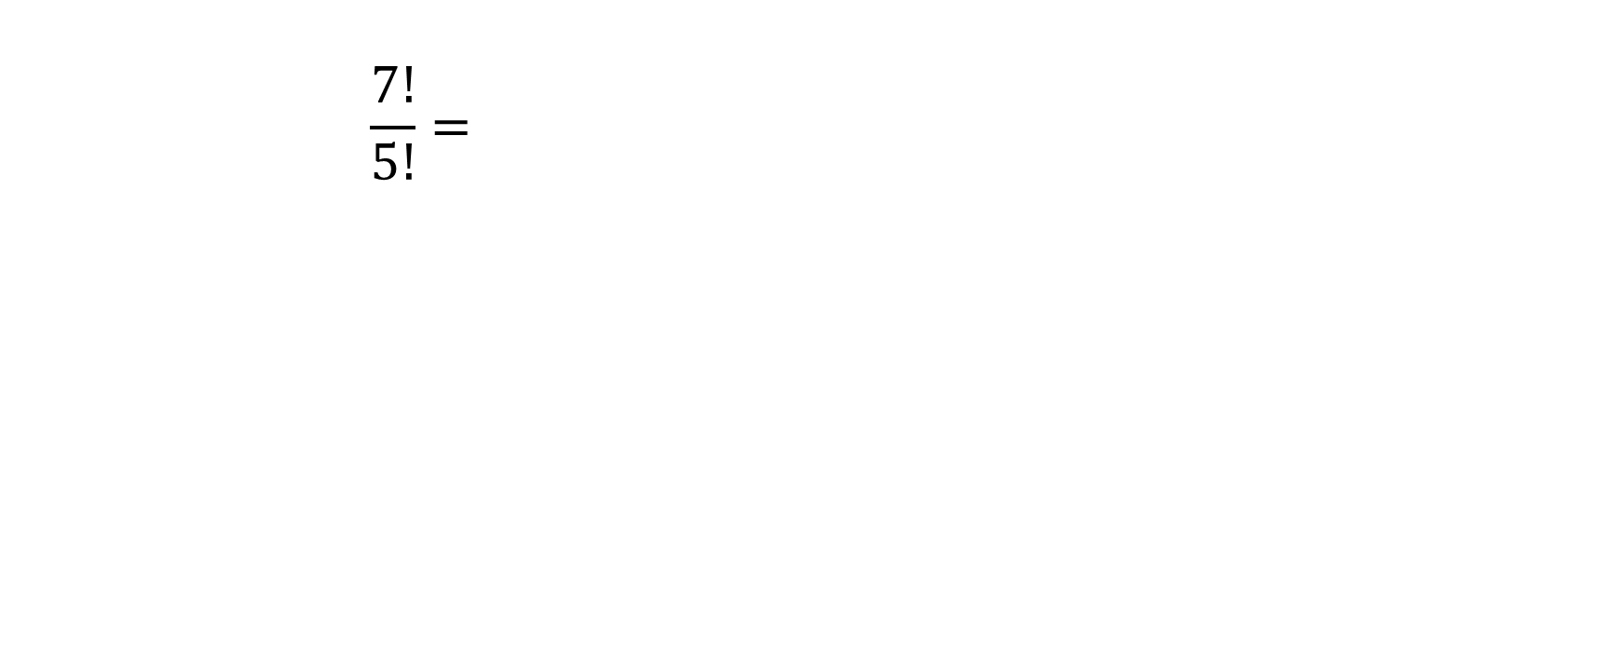
FACTORIAL: exercise
$$\frac{7!}{5!}=\frac{7⋅6⋅5⋅4⋅3⋅2⋅1}{5⋅4⋅3⋅2⋅1}=7⋅6=42$$
$$\frac{100!}{98!}=\frac{100⋅99⋅98!}{98!}=9900$$

Slide 66
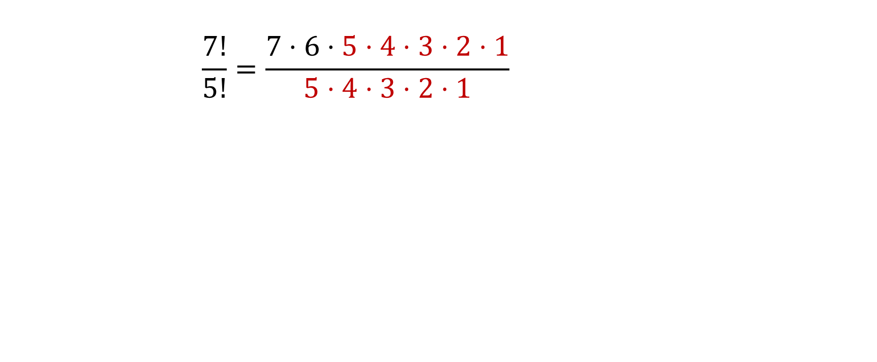
FACTORIAL: exercise
$$\frac{7!}{5!}=\frac{7⋅6⋅5⋅4⋅3⋅2⋅1}{5⋅4⋅3⋅2⋅1}=7⋅6=42$$
$$\frac{100!}{98!}=\frac{100⋅99⋅98!}{98!}=9900$$

Slide 67
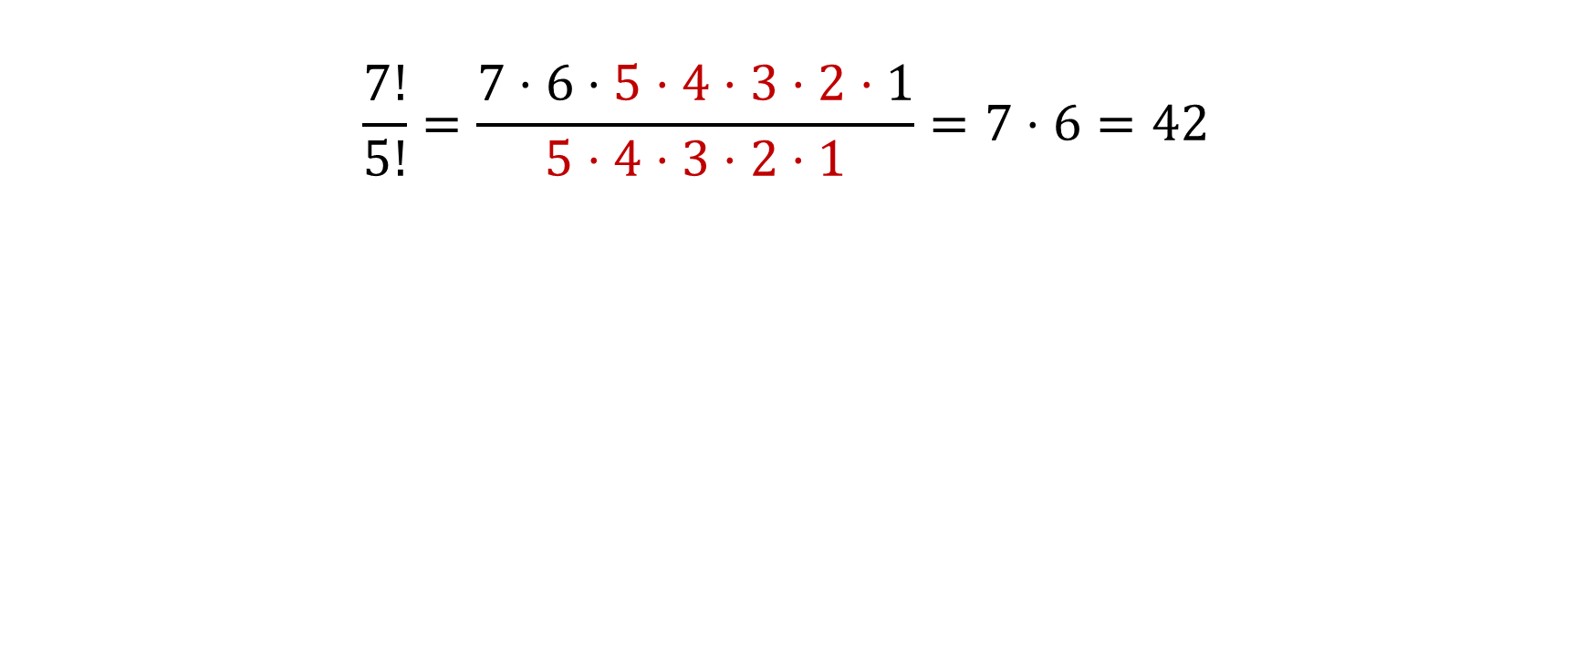
FACTORIAL: exercise
$$\frac{7!}{5!}=\frac{7⋅6⋅5⋅4⋅3⋅2⋅1}{5⋅4⋅3⋅2⋅1}=7⋅6=42$$
$$\frac{100!}{98!}=\frac{100⋅99⋅98!}{98!}=9900$$

Slide 68
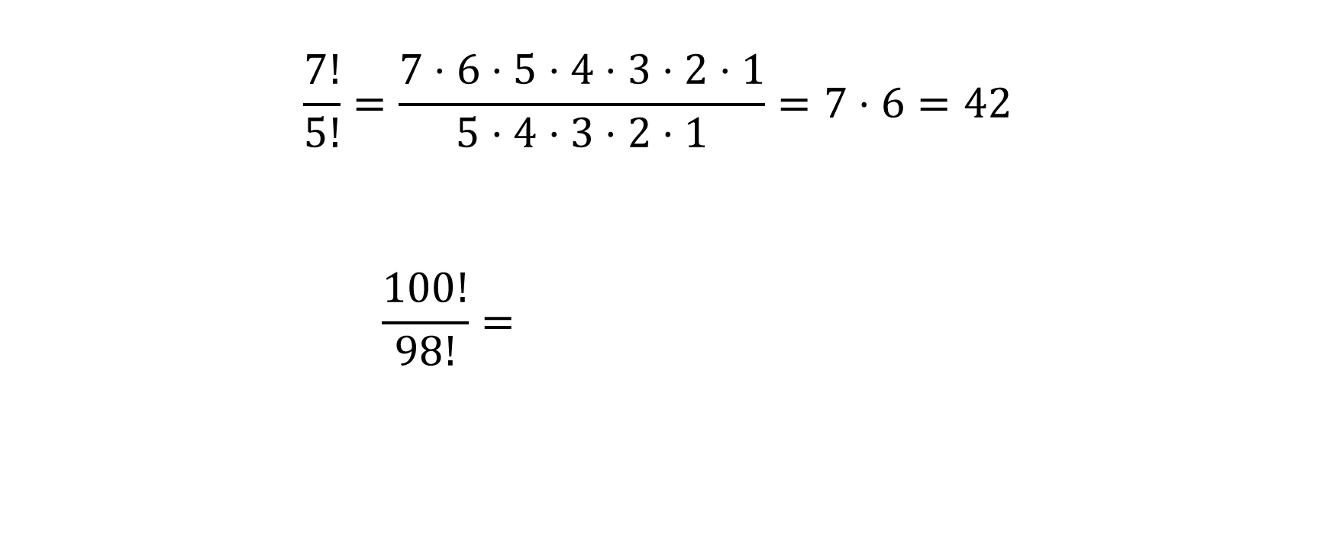
FACTORIAL: exercise
$$\frac{7!}{5!}=\frac{7⋅6⋅5⋅4⋅3⋅2⋅1}{5⋅4⋅3⋅2⋅1}=7⋅6=42$$
$$\frac{100!}{98!}=\frac{100⋅99⋅98!}{98!}=9900$$

Slide 69
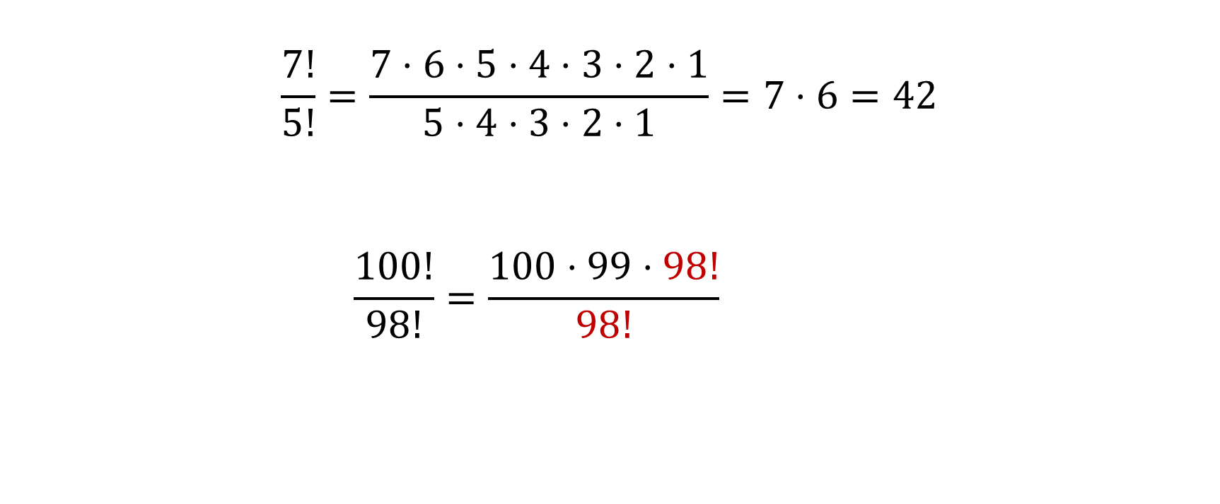
FACTORIAL: exercise
$$\frac{7!}{5!}=\frac{7⋅6⋅5⋅4⋅3⋅2⋅1}{5⋅4⋅3⋅2⋅1}=7⋅6=42$$
$$\frac{100!}{98!}=\frac{100⋅99⋅98!}{98!}=9900$$

Slide 70
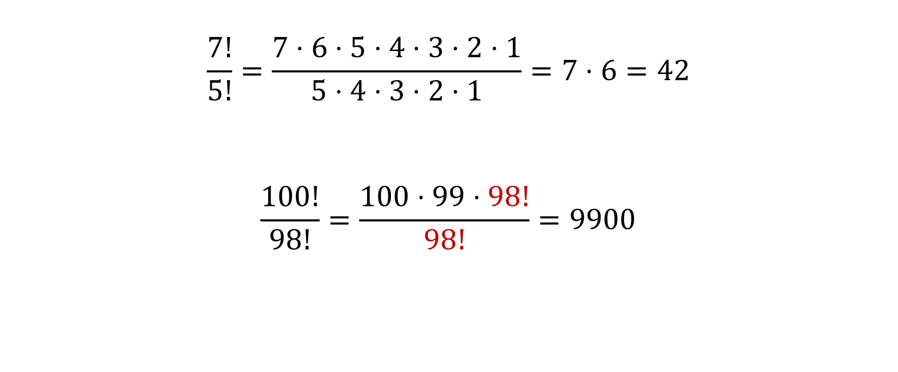
FACTORIAL: exercise
$$\frac{7!}{5!}=\frac{7⋅6⋅5⋅4⋅3⋅2⋅1}{5⋅4⋅3⋅2⋅1}=7⋅6=42$$
$$\frac{100!}{98!}=\frac{100⋅99⋅98!}{98!}=9900$$

Slide 71
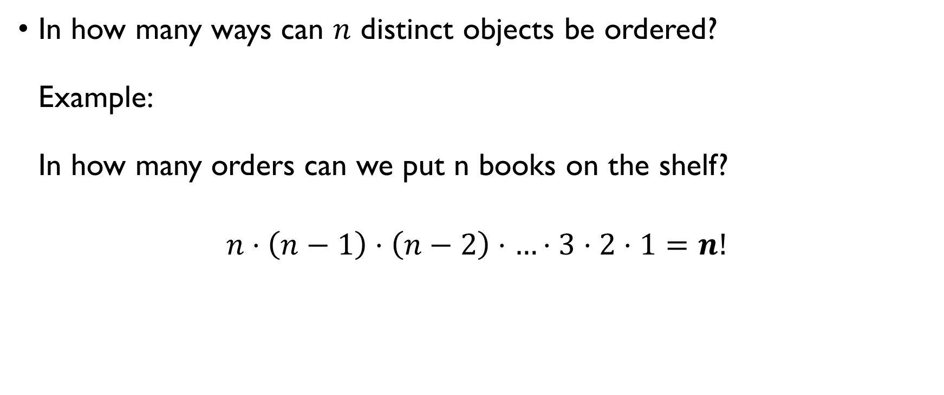
Permutations of $n$ elements
In how many ways can $n$ distinct objects be ordered? Example: In how many orders can we put n books on the shelf?
$$n⋅\left(n−1\right)⋅\left(n−2\right)⋅…⋅3⋅2⋅1=n!$$

Slide 72
A photograph
In how many ways can Ann, John, David, Mary and Sam line up for a photograph?
5! = 120 ways
In how many ways can they line up for a photograph, if Ann and John want to stand next to each other?
(Ann, John), David, Mary and Sam 2 x 4! = 48 ways

Slide 73
A photograph
In how many ways can Ann, John, David, Mary and Sam line up for a photograph?
5! = 120 ways
In how many ways can they line up for a photograph, if Ann and John want to stand next to each other?
(Ann, John), David, Mary and Sam 2 x 4! = 48 ways

Slide 74
A photograph
In how many ways can Ann, John, David, Mary and Sam line up for a photograph?
5! = 120 ways
In how many ways can they line up for a photograph, if Ann and John want to stand next to each other?
(Ann, John), David, Mary and Sam 2 x 4! = 48 ways

Slide 75
A photograph
In how many ways can Ann, John, David, Mary and Sam line up for a photograph?
5! = 120 ways
In how many ways can they line up for a photograph, if Ann and John want to stand next to each other?
(Ann, John), David, Mary and Sam 2 x 4! = 48 ways

Slide 76
A photograph
In how many ways can Ann, John, David, Mary and Sam line up for a photograph?
5! = 120 ways
In how many ways can they line up for a photograph, if Ann and John want to stand next to each other?
(Ann, John), David, Mary and Sam 2 x 4! = 48 ways

Slide 77
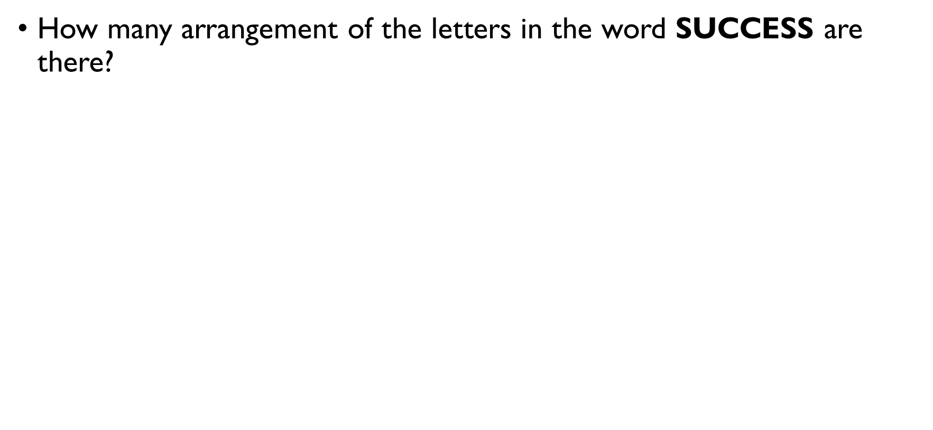
Repeated elements
How many arrangement of the letters in the word SUCCESS are there?
7 letters $→$ 7! different arrangements?
SUCCESS is the same as SUCCESS
SUCCESS is the same as SUCCESS, SUCCESS, SUCCESS, …
only $\frac{7!}{2!⋅3!}$ different arrangements

Slide 78
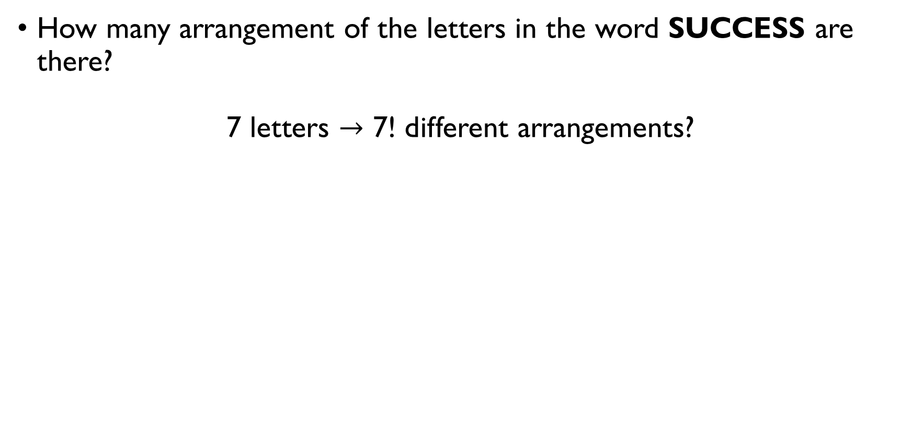
Repeated elements
How many arrangement of the letters in the word SUCCESS are there?
7 letters $→$ 7! different arrangements?
SUCCESS is the same as SUCCESS
SUCCESS is the same as SUCCESS, SUCCESS, SUCCESS, …
only $\frac{7!}{2!⋅3!}$ different arrangements

Slide 79
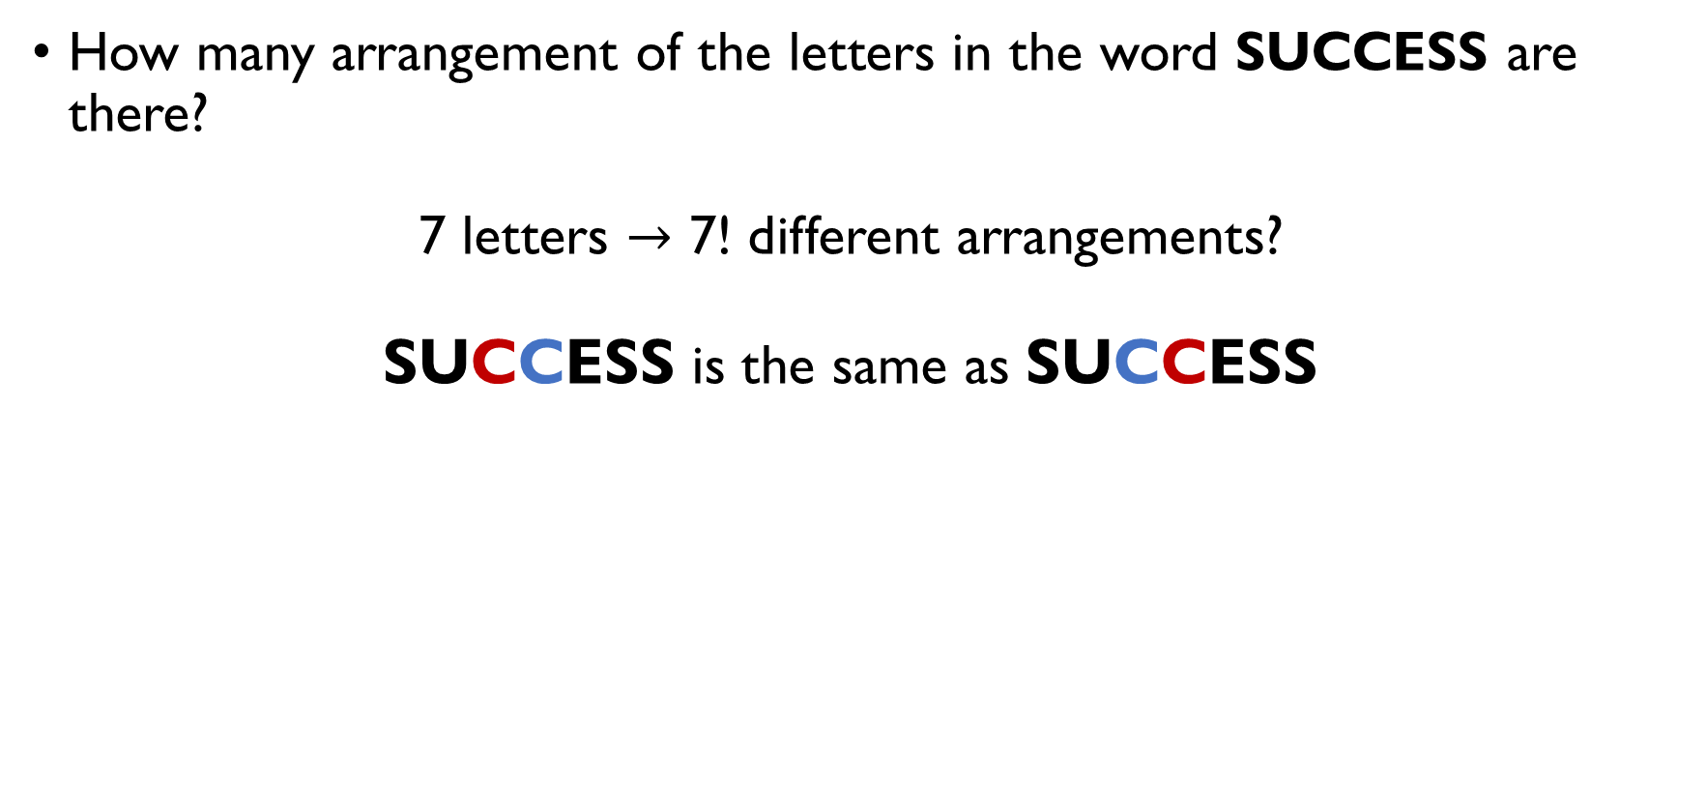
Repeated elements
How many arrangement of the letters in the word SUCCESS are there?
7 letters $→$ 7! different arrangements?
SUCCESS is the same as SUCCESS
SUCCESS is the same as SUCCESS, SUCCESS, SUCCESS, …
only $\frac{7!}{2!⋅3!}$ different arrangements

Slide 80
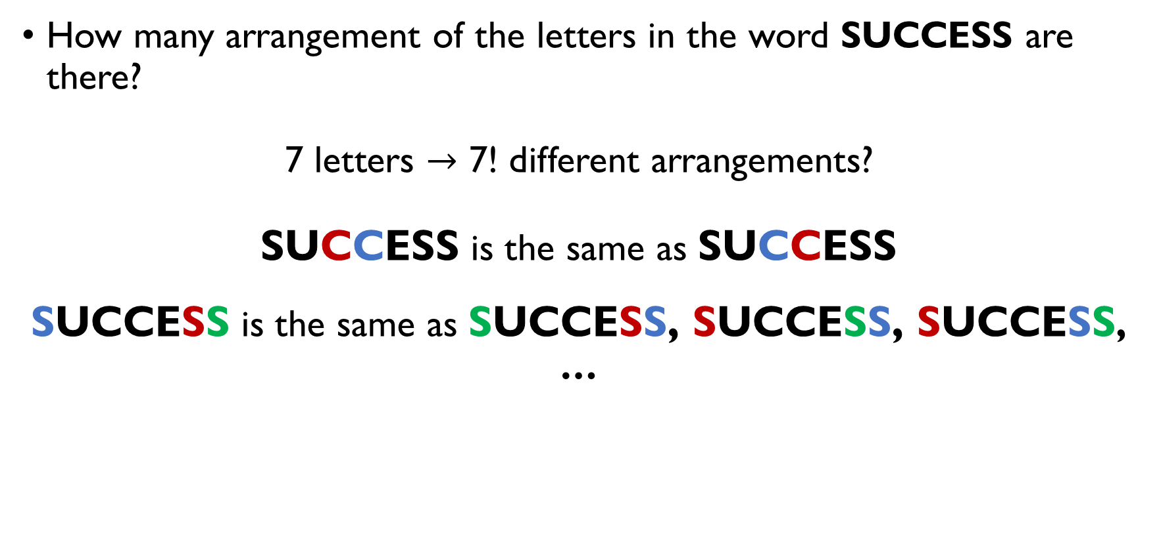
Repeated elements
How many arrangement of the letters in the word SUCCESS are there?
7 letters $→$ 7! different arrangements?
SUCCESS is the same as SUCCESS
SUCCESS is the same as SUCCESS, SUCCESS, SUCCESS, …
only $\frac{7!}{2!⋅3!}$ different arrangements

Slide 81

Repeated elements
How many arrangement of the letters in the word SUCCESS are there?
7 letters $→$ 7! different arrangements?
SUCCESS is the same as SUCCESS
SUCCESS is the same as SUCCESS, SUCCESS, SUCCESS, …
only $\frac{7!}{2!⋅3!}$ different arrangements

Slide 82
Repeated elements
How many arrangement of the letters in the word SUCCESS are there?
7 letters $→$ 7! different arrangements?
SUCCESS is the same as SUCCESS
SUCCESS is the same as SUCCESS, SUCCESS, SUCCESS, …
only $\frac{7!}{2!⋅3!}$ different arrangements

Slide 83

Repeated elements
If among $n$ elements $k≤n$ elements are not unique, with $n_{1}, n_{2}, …, n_{k}$repetitions respectively, then the number of possible permutations is
$$\frac{n!}{n_{1}!⋅n_{2}!⋅…⋅n_{k}!}$$

Slide 84


Spot a problem in the text
Source: TEDEd

Slide 85

aNAGRAM
In how many different ways can ANAGRAM really be arranged?
The word ANAGRAM contains 5 unique characters: A, N, G, R, M.
A is repeated 3 times.
Therefore, the # of possible arrangements is only
$$\frac{7!}{3!}=7⋅6⋅5⋅4=840$$

Slide 86

aNAGRAM
In how many different ways can ANAGRAM really be arranged?
The word ANAGRAM contains 5 unique characters: A, N, G, R, M.
A is repeated 3 times.
Therefore, the # of possible arrangements is only
$$\frac{7!}{3!}=7⋅6⋅5⋅4=840$$

Slide 87

aNAGRAM
In how many different ways can ANAGRAM really be arranged?
The word ANAGRAM contains 5 unique characters: A, N, G, R, M.
A is repeated 3 times.
Therefore, the # of possible arrangements is only
$$\frac{7!}{3!}=7⋅6⋅5⋅4=840$$

Slide 88

aNAGRAM
In how many different ways can ANAGRAM really be arranged?
The word ANAGRAM contains 5 unique characters: A, N, G, R, M.
A is repeated 3 times.
Therefore, the # of possible arrangements is only
$$\frac{7!}{3!}=7⋅6⋅5⋅4=840$$

Slide 89

aNAGRAM
In how many different ways can ANAGRAM really be arranged?
The word ANAGRAM contains 5 unique characters: A, N, G, R, M.
A is repeated 3 times.
Therefore, the # of possible arrangements is only
$$\frac{7!}{3!}=7⋅6⋅5⋅4=840$$

Slide 90

That’s not entirely true either
Source: TEDEd

Slide 91

TOM MARVOLO RIDDLE
TOM MARVOLO RIDDLE has 16 characters:
Therefore, the # on arrangements is
$$\frac{16!}{3!⋅2!⋅2!⋅2!⋅2!}=15⋅14⋅…⋅4$$
T O (3 times) M (2 times) A R (2 times) | V L (2 times) I D (2 times) E

Slide 92

TOM MARVOLO RIDDLE
TOM MARVOLO RIDDLE has 16 characters:
Therefore, the # on arrangements is
$$\frac{16!}{3!⋅2!⋅2!⋅2!⋅2!}=15⋅14⋅…⋅4$$
T O (3 times) M (2 times) A R (2 times) | V L (2 times) I D (2 times) E

Slide 93

TOM MARVOLO RIDDLE
TOM MARVOLO RIDDLE has 16 characters:
Therefore, the # on arrangements is
$$\frac{16!}{3!⋅2!⋅2!⋅2!⋅2!}=15⋅14⋅…⋅4$$
T O (3 times) M (2 times) A R (2 times) | V L (2 times) I D (2 times) E

Slide 94

TOM MARVOLO RIDDLE
TOM MARVOLO RIDDLE has 16 characters:
Therefore, the # on arrangements is
$$\frac{16!}{3!⋅2!⋅2!⋅2!⋅2!}=15⋅14⋅…⋅4$$
T O (3 times) M (2 times) A R (2 times) | V L (2 times) I D (2 times) E

Slide 95

R-permutations
An ordered arrangement of $r≤n$ elements of a set of $n$ elements is called an $r$-permutation. Notation: $P\left(n, r\right)$ Example: How many ways are there to choose a president, vice-president, and secretary from a group of 17 people?

Slide 96

R-permutations
An ordered arrangement of $r≤n$ elements of a set of $n$ elements is called an $r$-permutation. Notation: $P\left(n, r\right)$ Example: How many ways are there to choose a president, vice-president, and secretary from a group of 17 people?

Slide 97

R-permutations
An ordered arrangement of $r≤n$ elements of a set of $n$ elements is called an $r$-permutation. Notation: $P\left(n, r\right)$ Example: How many ways are there to choose a president, vice-president, and secretary from a group of 17 people?

Slide 98

Committee
How many ways are there to choose a president, vice-president, and secretary from a group of 17 people?
$$17⋅16⋅15=4080$$
Note that:
$$17⋅16⋅15=\frac{17!}{14!}=\frac{17!}{\left(17−3\right)!}$$

Slide 99

Committee
How many ways are there to choose a president, vice-president, and secretary from a group of 17 people?
$$17⋅16⋅15=4080$$
Note that:
$$17⋅16⋅15=\frac{17!}{14!}=\frac{17!}{\left(17−3\right)!}$$

Slide 100

Committee
How many ways are there to choose a president, vice-president, and secretary from a group of 17 people?
$$17⋅16⋅15=4080$$
Note that:
$$17⋅16⋅15=\frac{17!}{14!}=\frac{17!}{\left(17−3\right)!}$$

Slide 101

R-permutations: general case
How many ways are there to form a committee of $r$ people from a group of $n$ people, if every member has her own role?
$$n⋅\left(n−1\right)⋅…⋅\left(n−r+1\right)=\frac{n!}{\left(n−r\right)!}$$

Slide 102

R-permutations: general case
How many ways are there to form a committee of $r$ people from a group of $n$ people, if every member has her own role?
$$n⋅\left(n−1\right)⋅…⋅\left(n−r+1\right)=\frac{n!}{\left(n−r\right)!}$$

Slide 103

R-permutations: general case
How many ways are there to form a committee of $r$ people from a group of $n$ people, if every member has her own role?
$$n⋅\left(n−1\right)⋅…⋅\left(n−r+1\right)=\frac{n!}{\left(n−r\right)!}$$

Slide 104
COMBINATIONS
Order doesn’t matter

Slide 105

combinations
How many committees of two people can be chosen from this group of four people:
Jones, Chan, Vello, Harris
Number of 2-permutations: $4!/\left(4−3\right)!=12$
Since the roles are the same, many of these are the same…

Slide 106

combinations
How many committees of two people can be chosen from this group of four people:
Jones, Chan, Vello, Harris
Number of 2-permutations: $4!/\left(4−3\right)!=12$
Since the roles are the same, many of these are the same…

Slide 107

combinations
How many committees of two people can be chosen from this group of four people:
Jones, Chan, Vello, Harris
Number of 2-permutations: $4!/\left(4−3\right)!=12$
Since the roles are the same, many of these are the same…

Slide 108

combinations
How many committees of two people can be chosen from this group of four people:
Jones, Chan, Vello, Harris
Number of 2-permutations: $4!/\left(4−3\right)!=12$
Since the roles are the same, many of these are the same…

Slide 109

combinations
How many committees of two people can be chosen from this group of four people:
Jones, Chan, Vello, Harris
Number of 2-permutations: $4!/\left(4−3\right)!=12$
Since the roles are the same, many of these are the same…

Slide 110

combinations
How many committees of two people can be chosen from this group of four people:
Jones, Chan, Vello, Harris
Number of 2-permutations: $4!/\left(4−3\right)!=12$
Since the roles are the same, many of these are the same. How do we fix this?
People in the committee are indistinguishable and can be re-ordered in 2! ways:
$\frac{4!}{2!\left(4−3\right)!}$ different committees

Slide 111

combinations
How many committees of two people can be chosen from this group of four people:
Jones, Chan, Vello, Harris
Number of 2-permutations: $4!/\left(4−3\right)!=12$
Since the roles are the same, many of these are the same. How do we fix this?
People in the committee are indistinguishable and can be re-ordered in 2! ways:
$\frac{4!}{2!\left(4−3\right)!}$ different committees

Slide 112

combinations
How many committees of two people can be chosen from this group of four people:
Jones, Chan, Vello, Harris
Number of 2-permutations: $4!/\left(4−3\right)!=12$
Since the roles are the same, many of these are the same. How do we fix this?
People in the committee are indistinguishable and can be re-ordered in 2! ways:
$\frac{4!}{2!\left(4−3\right)!}$ different committees

Slide 113

combinations
How many committees of two people can be chosen from this group of four people:
Jones, Chan, Vello, Harris
Number of 2-permutations: $4!/\left(4−3\right)!=12$
Since the roles are the same, many of these are the same. How do we fix this?
People in the committee are indistinguishable and can be re-ordered in 2! ways:
$\frac{4!}{2!\left(4−3\right)!}$ different committees

Slide 114

Combinations: General case
Suppose we want to choose $k$ elements from a set with $n$ elements, in no specific order. In other words: select a subset of size $k$ from a set of size $n$.
How many different ways to do so are there?
$$C\left(n,k\right)=\frac{n!}{k!\left(n−k\right)!}$$

Slide 115

Combinations: General case
Suppose we want to choose $k$ elements from a set with $n$ elements, in no specific order. In other words: select a subset of size $k$ from a set of size $n$.
How many different ways to do so are there?
$$C\left(n,k\right)=\frac{n!}{k!\left(n−k\right)!}$$

Slide 116

Combinations: General case
Suppose we want to choose $k$ elements from a set with $n$ elements, in no specific order. In other words: select a subset of size $k$ from a set of size $n$.
How many different ways to do so are there?
$$C\left(n,k\right)=\frac{n!}{k!\left(n−k\right)!}$$

Slide 117

notation
$$C\left(n,k\right)=\left(\begin{matrix}n \\ k\end{matrix}\right)=C_{n}^{k}=\frac{n!}{k!\left(n−k\right)!}$$

Slide 118

Spot a problem here
Source: UC Berkeley

Slide 119

combinations
Consider the formulas:
$${\left(a+b\right)}^{2}=a^{2}+2ab+b^{2}$$
$$\left(a+b\right)\left(a+b\right)=a^{2}+ab+ab+b^{2}$$
$${\left(a+b\right)}^{2}=a^{3}+3a^{2}b+3ab^{2}+b^{3}$$
$$\left(a+b\right)\left(a+b\right)\left(a+b\right)==a^{3}+a^{2}b+aba+ab^{2}+ba^{2}+b^{2}a+bab+b^{3}$$

Slide 120

combinations
Consider the formulas:
$${\left(a+b\right)}^{2}=a^{2}+2ab+b^{2}$$
$$\left(a+b\right)\left(a+b\right)=a^{2}+ab+ab+b^{2}$$
$${\left(a+b\right)}^{2}=a^{3}+3a^{2}b+3ab^{2}+b^{3}$$
$$\left(a+b\right)\left(a+b\right)\left(a+b\right)==a^{3}+a^{2}b+aba+ab^{2}+ba^{2}+b^{2}a+bab+b^{3}$$

Slide 121

combinations
Consider the formulas:
$${\left(a+b\right)}^{2}=a^{2}+2ab+b^{2}$$
$$\left(a+b\right)\left(a+b\right)=a^{2}+ab+ab+b^{2}$$
$${\left(a+b\right)}^{3}=a^{3}+3a^{2}b+3ab^{2}+b^{3}$$
$$\left(a+b\right)\left(a+b\right)\left(a+b\right)==a^{3}+a^{2}b+aba+ab^{2}+ba^{2}+b^{2}a+bab+b^{3}$$

Slide 122

Binomial theorem
$${\left(a+b\right)}^{n}=\sum_{i=0}^{n}{C\left(n,i\right)⋅a^{n−i}b^{i}}$$
Example:
$${\left(a+b\right)}^{4}=$$
$$=C\left(4,0\right)⋅a^{4}+C\left(4,1\right)a^{3}b+C\left(4,2\right)⋅a^{2}b^{2}+C\left(4,3\right)ab^{3}+C\left(4,1\right)⋅b^{4}==a^{4}+4a^{3}b+3a^{2}b^{2}+3ab^{3}+b^{4}$$

Slide 123

Binomial theorem
$${\left(a+b\right)}^{n}=\sum_{i=0}^{n}{C\left(n,i\right)⋅a^{n−i}b^{i}}$$
Example:
$${\left(a+b\right)}^{4}=$$
$$=C\left(4,0\right)⋅a^{4}+C\left(4,1\right)a^{3}b+C\left(4,2\right)⋅a^{2}b^{2}+C\left(4,3\right)ab^{3}+C\left(4,1\right)⋅b^{4}==a^{4}+4a^{3}b+3a^{2}b^{2}+3ab^{3}+b^{4}$$

Slide 124

Binomial theorem
$${\left(a+b\right)}^{n}=\sum_{i=0}^{n}{C\left(n,i\right)⋅a^{n−i}b^{i}}$$
Example:
$${\left(a+b\right)}^{4}=$$
$$=C\left(4,0\right)⋅a^{4}+C\left(4,1\right)a^{3}b+C\left(4,2\right)⋅a^{2}b^{2}+C\left(4,3\right)ab^{3}+C\left(4,4\right)⋅b^{4}==a^{4}+4a^{3}b+3a^{2}b^{2}+3ab^{3}+b^{4}$$

Slide 125

Binomial theorem
$${\left(a+b\right)}^{n}=\sum_{i=0}^{n}{C\left(n,i\right)⋅a^{n−i}b^{i}}$$
Example:
$${\left(a+b\right)}^{4}=$$
$$=C\left(4,0\right)⋅a^{4}+C\left(4,1\right)a^{3}b+C\left(4,2\right)⋅a^{2}b^{2}+C\left(4,3\right)ab^{3}+C\left(4,4\right)⋅b^{4}==a^{4}+4a^{3}b+3a^{2}b^{2}+4ab^{3}+b^{4}$$

Slide 126

Sum of Binomial coefficients
Can you guess the value of the following sum
$$C\left(n,0\right)+C\left(n,1\right)+C\left(n,2\right)+…+C\left(n, n−1\right)+C\left(n,n\right)= ?$$
$C\left(n,k\right)$ - number of subsets of size $k$.
In the sum above, $k=0,…n⟺$ consider all possible subsets and sum up how many of them are there.
Thus, the sum above = number of subsets of a set of size $n$.
How many subsets does a set of $n$ elements have? $2^{n}$.

Slide 127

Sum of Binomial coefficients
Can you guess the value of the following sum
$$C\left(n,0\right)+C\left(n,1\right)+C\left(n,2\right)+…+C\left(n, n−1\right)+C\left(n,n\right)= ?$$
$C\left(n,k\right)$ - number of subsets of size $k$.
In the sum above, $k=0,…n⟺$ consider all possible subsets and sum up how many of them are there.
Thus, the sum above = number of subsets of a set of size $n$.
How many subsets does a set of $n$ elements have? $2^{n}$.

Slide 128

Sum of Binomial coefficients
Can you guess the value of the following sum
$$C\left(n,0\right)+C\left(n,1\right)+C\left(n,2\right)+…+C\left(n, n−1\right)+C\left(n,n\right)= ?$$
$C\left(n,k\right)$ - number of subsets of size $k$.
In the sum above, $k=0,…n⟺$ consider all possible subsets and sum up how many of them are there.
Thus, the sum above = number of subsets of a set of size $n$.
How many subsets does a set of $n$ elements have? $2^{n}$.

Slide 129

Sum of Binomial coefficients
Can you guess the value of the following sum
$$C\left(n,0\right)+C\left(n,1\right)+C\left(n,2\right)+…+C\left(n, n−1\right)+C\left(n,n\right)= ?$$
$C\left(n,k\right)$ - number of subsets of size $k$.
In the sum above, $k=0,…n⟺$ consider all possible subsets and sum up how many of them are there.
Thus, the sum above = number of subsets of a set of size $n$.
How many subsets does a set of $n$ elements have? $2^{n}$.

Slide 130

Sum of Binomial coefficients
Can you guess the value of the following sum
$$C\left(n,0\right)+C\left(n,1\right)+C\left(n,2\right)+…+C\left(n, n−1\right)+C\left(n,n\right)=2^{n}\text{.}$$
$C\left(n,k\right)$ - number of subsets of size $k$.
In the sum above, $k=0,…n⟺$ consider all possible subsets and sum up how many of them are there.
Thus, the sum above = number of subsets of a set of size $n$.
How many subsets does a set of $n$ elements have? $2^{n}$.

Slide 131

Pascal’s triangle

Slide 132
PASCAL’S TRIANGLE
https://youtu.be/XMriWTvPXHI

Slide 133

salads
Is this true?
Assume that
there are exactly 50 ingredients;
letuce (salad base) is one of them, so there are 49 ingredients left;
you can still choose 5 ingredients in addition to the base.

Slide 134

salads
Is this true?
$$C\left(49,5\right)=\frac{49!}{5!\left(49−5\right)!}=$$
$$=\frac{49⋅48⋅47⋅46⋅45⋅44!}{5⋅4⋅3⋅2⋅44!}=$$
$$=\frac{49⋅48⋅47⋅46⋅45}{120}=$$
$$=1,906,884$$

Slide 135

salads
Is this true?
$$C\left(49,5\right)=\frac{49!}{5!\left(49−5\right)!}=$$
$$=\frac{49⋅48⋅47⋅46⋅45⋅44!}{5⋅4⋅3⋅2⋅44!}=$$
$$=\frac{49⋅48⋅47⋅46⋅45}{120}=$$
$$=1,906,884$$

Slide 136

salads
Is this true?
$$C\left(49,5\right)=\frac{49!}{5!\left(49−5\right)!}=$$
$$=\frac{49⋅48⋅47⋅46⋅45⋅44!}{5⋅4⋅3⋅2⋅44!}=$$
$$=\frac{49⋅48⋅47⋅46⋅45}{120}=$$
$$=1,906,884$$

Slide 137
PERMUTATIONS VS COMBINATIONS

Slide 138

Committee 1
A committee should consist of 3 faculty members and 2 students:
faculty members can be chosen from 6 eligible candidates;
students can be chosen from 5 eligible candidates.
How many different committees are possible?
$C\left(6, 3\right)=\frac{6!}{3!\left(6−3\right)!}=20$ ways to chose a faculty member.
$C\left(5, 2\right)=\frac{5!}{2!\left(5−2\right)!}=10$ ways to chose a students.
Product rule: 20 x 10 different committees are possible

Slide 139

Committee 1
A committee should consist of 3 faculty members and 2 students:
faculty members can be chosen from 6 eligible candidates;
students can be chosen from 5 eligible candidates.
How many different committees are possible?
$C\left(6, 3\right)=\frac{6!}{3!\left(6−3\right)!}=20$ ways to chose a faculty member.
$C\left(5, 2\right)=\frac{5!}{2!\left(5−2\right)!}=10$ ways to chose a students.
Product rule: 20 x 10 different committees are possible

Slide 140

Committee 1
A committee should consist of 3 faculty members and 2 students:
faculty members can be chosen from 6 eligible candidates;
students can be chosen from 5 eligible candidates.
How many different committees are possible?
$C\left(6, 3\right)=\frac{6!}{3!\left(6−3\right)!}=20$ ways to chose a faculty member.
$C\left(5, 2\right)=\frac{5!}{2!\left(5−2\right)!}=10$ ways to chose a students.
Product rule: 20 x 10 different committees are possible

Slide 141

Committee 1
A committee should consist of 3 faculty members and 2 students:
faculty members can be chosen from 6 eligible candidates;
students can be chosen from 5 eligible candidates.
How many different committees are possible?
$C\left(6, 3\right)=\frac{6!}{3!\left(6−3\right)!}=20$ ways to chose a faculty member.
$C\left(5, 2\right)=\frac{5!}{2!\left(5−2\right)!}=10$ ways to chose a students.
Product rule: 20 x 10 different committees are possible

Slide 142

Committee 1
A committee should consist of 3 faculty members and 2 students:
faculty members can be chosen from 6 eligible candidates;
students can be chosen from 5 eligible candidates.
How many different committees are possible?
$C\left(6, 3\right)=\frac{6!}{3!\left(6−3\right)!}=20$ ways to chose a faculty member.
$C\left(5, 2\right)=\frac{5!}{2!\left(5−2\right)!}=10$ ways to chose a students.
Product rule: 20 x 10 different committees are possible

Slide 143

Committee 1
A committee should consist of 3 faculty members and 2 students:
faculty members can be chosen from 6 eligible candidates;
students can be chosen from 5 eligible candidates.
How many different committees are possible?
$C\left(6, 3\right)=\frac{6!}{3!\left(6−3\right)!}=20$ ways to chose a faculty member.
$C\left(5, 2\right)=\frac{5!}{2!\left(5−2\right)!}=10$ ways to chose a students.
Product rule: 20 x 10 different committees are possible

Slide 144

Committee 1
A committee should consist of 3 faculty members and 2 students:
faculty members can be chosen from 6 eligible candidates;
students can be chosen from 5 eligible candidates.
How many different committees are possible?
$C\left(6, 3\right)=\frac{6!}{3!\left(6−3\right)!}=20$ ways to chose a faculty member.
$C\left(5, 2\right)=\frac{5!}{2!\left(5−2\right)!}=10$ ways to chose a students.
Product rule: 20 x 10 different committees are possible

Slide 145

Committee 1
A committee should consist of 3 faculty members and 2 students:
faculty members can be chosen from 6 eligible candidates;
students can be chosen from 5 eligible candidates.
How many different committees are possible?
$C\left(6, 3\right)=\frac{6!}{3!\left(6−3\right)!}=20$ ways to chose a faculty member.
$C\left(5, 2\right)=\frac{5!}{2!\left(5−2\right)!}=10$ ways to chose a students.
Product rule: 20 x 10 different committees are possible

Slide 146

Committee 2
A total of 6 seniors and 5 juniors have been nominated for a 6-person committee, which should consist of 3 seniors and 3 juniors. One senior will be chosen as president, one as vice-president, and one as secretary. The three juniors will not have any special title.
How many such committees are possible?
Ways to chose the seniors (roles = order matters = permutation):
$$P\left(6, 4\right)= 6⋅5⋅4=120$$
Ways to chose the juniors (no roles = order doesn’t matter = combination):
$$C\left(5, 3\right)=\frac{5!}{3!\left(5−3\right)!}=10$$
Product rule: 120 x 10 = 1200 different committees possible

Slide 147

Committee 2
A total of 6 seniors and 5 juniors have been nominated for a 6-person committee, which should consist of 3 seniors and 3 juniors. One senior will be chosen as president, one as vice-president, and one as secretary. The three juniors will not have any special title.
How many such committees are possible?
Ways to chose the seniors (roles = order matters = permutation):
$$P\left(6, 4\right)= 6⋅5⋅4=120$$
Ways to chose the juniors (no roles = order doesn’t matter = combination):
$$C\left(5, 3\right)=\frac{5!}{3!\left(5−3\right)!}=10$$
Product rule: 120 x 10 = 1200 different committees possible

Slide 148

Committee 2
A total of 6 seniors and 5 juniors have been nominated for a 6-person committee, which should consist of 3 seniors and 3 juniors. One senior will be chosen as president, one as vice-president, and one as secretary. The three juniors will not have any special title.
How many such committees are possible?
Ways to chose the seniors (roles = order matters = permutation):
$$P\left(6, 4\right)= 6⋅5⋅4=120$$
Ways to chose the juniors (no roles = order doesn’t matter = combination):
$$C\left(5, 3\right)=\frac{5!}{3!\left(5−3\right)!}=10$$
Product rule: 120 x 10 = 1200 different committees possible

Slide 149

Committee 2
A total of 6 seniors and 5 juniors have been nominated for a 6-person committee, which should consist of 3 seniors and 3 juniors. One senior will be chosen as president, one as vice-president, and one as secretary. The three juniors will not have any special title.
How many such committees are possible?
Ways to chose the seniors (roles = order matters = permutation):
$$P\left(6, 4\right)= 6⋅5⋅4=120$$
Ways to chose the juniors (no roles = order doesn’t matter = combination):
$$C\left(5, 3\right)=\frac{5!}{3!\left(5−3\right)!}=10$$
Product rule: 120 x 10 = 1200 different committees possible

Slide 150

Committee 2
A total of 6 seniors and 5 juniors have been nominated for a 6-person committee, which should consist of 3 seniors and 3 juniors. One senior will be chosen as president, one as vice-president, and one as secretary. The three juniors will not have any special title.
How many such committees are possible?
Ways to chose the seniors (roles = order matters = permutation):
$$P\left(6, 4\right)= 6⋅5⋅4=120$$
Ways to chose the juniors (no roles = order doesn’t matter = combination):
$$C\left(5, 3\right)=\frac{5!}{3!\left(5−3\right)!}=10$$
Product rule: 120 x 10 = 1200 different committees possible

Slide 151

Committee 2
A total of 6 seniors and 5 juniors have been nominated for a 6-person committee, which should consist of 3 seniors and 3 juniors. One senior will be chosen as president, one as vice-president, and one as secretary. The three juniors will not have any special title.
How many such committees are possible?
Ways to chose the seniors (roles = order matters = permutation):
$$P\left(6, 4\right)= 6⋅5⋅4=120$$
Ways to chose the juniors (no roles = order doesn’t matter = combination):
$$C\left(5, 3\right)=\frac{5!}{3!\left(5−3\right)!}=10$$
Product rule: 120 x 10 = 1200 different committees possible

Slide 152

TO SUM UP
Imagine you have $n$ objects. How can you arrange them?
 | WITHOUT REPETITIONS | WITH REPETITIONS
ORDERED | PERMUTATIONS In how many ways can $n$ people sit in a row? | How many different $n$-bit strings are there?
NOT ORDERED | COMBINATIONS In how many ways can we chose $k$ out of $n$ different candies in a bag? | In how many ways can we distribute $n$ identical candies among k kids?

Slide 153
PRACTICE
https://docs.google.com/document/d/19EoiAc5JypihiBKOUOFcarzgiCXHAUbv9sQBg47Kelg/edit?usp=sharing

